Slide 1
Laboratory safety
Tobias Christensen
Notes:
½

Slide 2
Introduction
Create a safe and pleasant workspace across the laboratories
GLP – Good laboratory practice
Laboratory safety guidelines 2020
Studienet replaces safety compendium

Slide 3
Accidents
Acute emergencies and fire call: 1-1-2
Not acute injuries that require treatment call: 18 18
Opening hours: Weekday at 14-22 / Weekends and holidays at. 10-20
Staff: Specially trained nurses
Address: Kalundborg Sundheds- og Akuthus, Nørre Allé 31, 4400 Kalundborg (Call beforehand)
Insurance
Contingency plan
Teacher or L-AMU

Slide 4
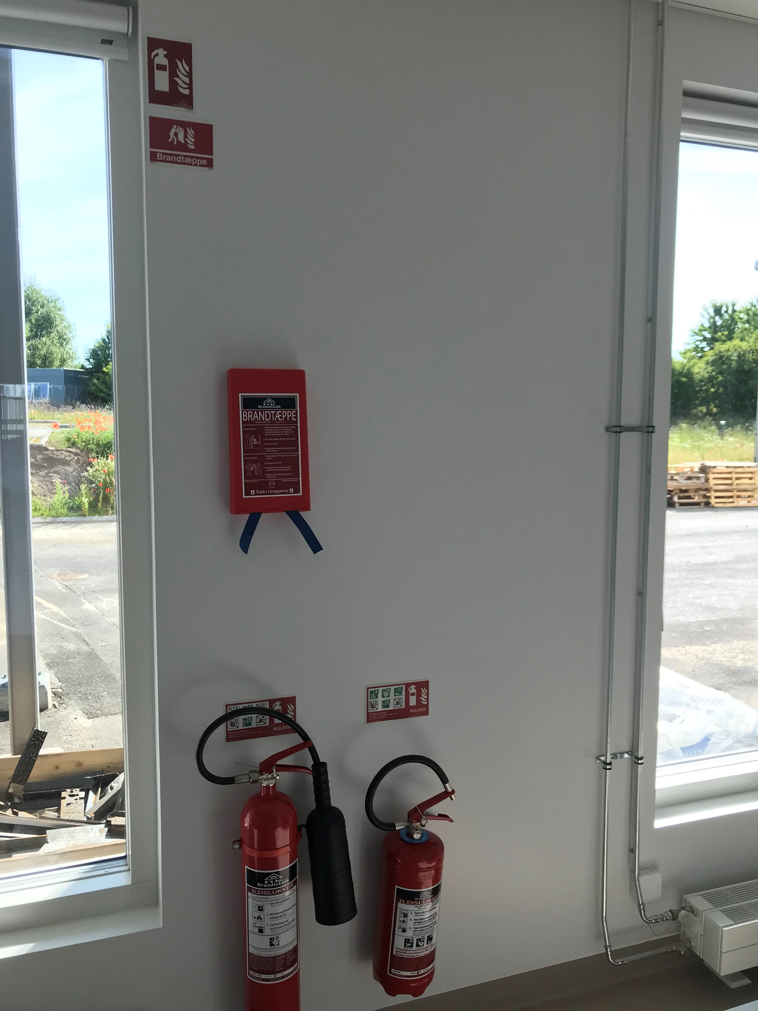
Fire
Restrict the fire if unable evacuate and call 1-1-2
Choose the right metode for fire fighting!
Fire blanket/ lab coat
Water/ emergency shower
CO2 extinguisher, present in all laboratories
Powder extinguisher present in KalA0.01, KalA0.02 & KalA0.05
Types of fire | Equipment | Location
Person or solid matter (not metal) | Emergency shower, water or fire blanket/lab coat | Entrance to laboratories, sinks and lab coat
Fluid, gas or equipment | Carbon dioxide extinguisher | Present in laboratories, look for the signs
Metal | Powder extinguisher | KalA0.01,02 & 05

Slide 5
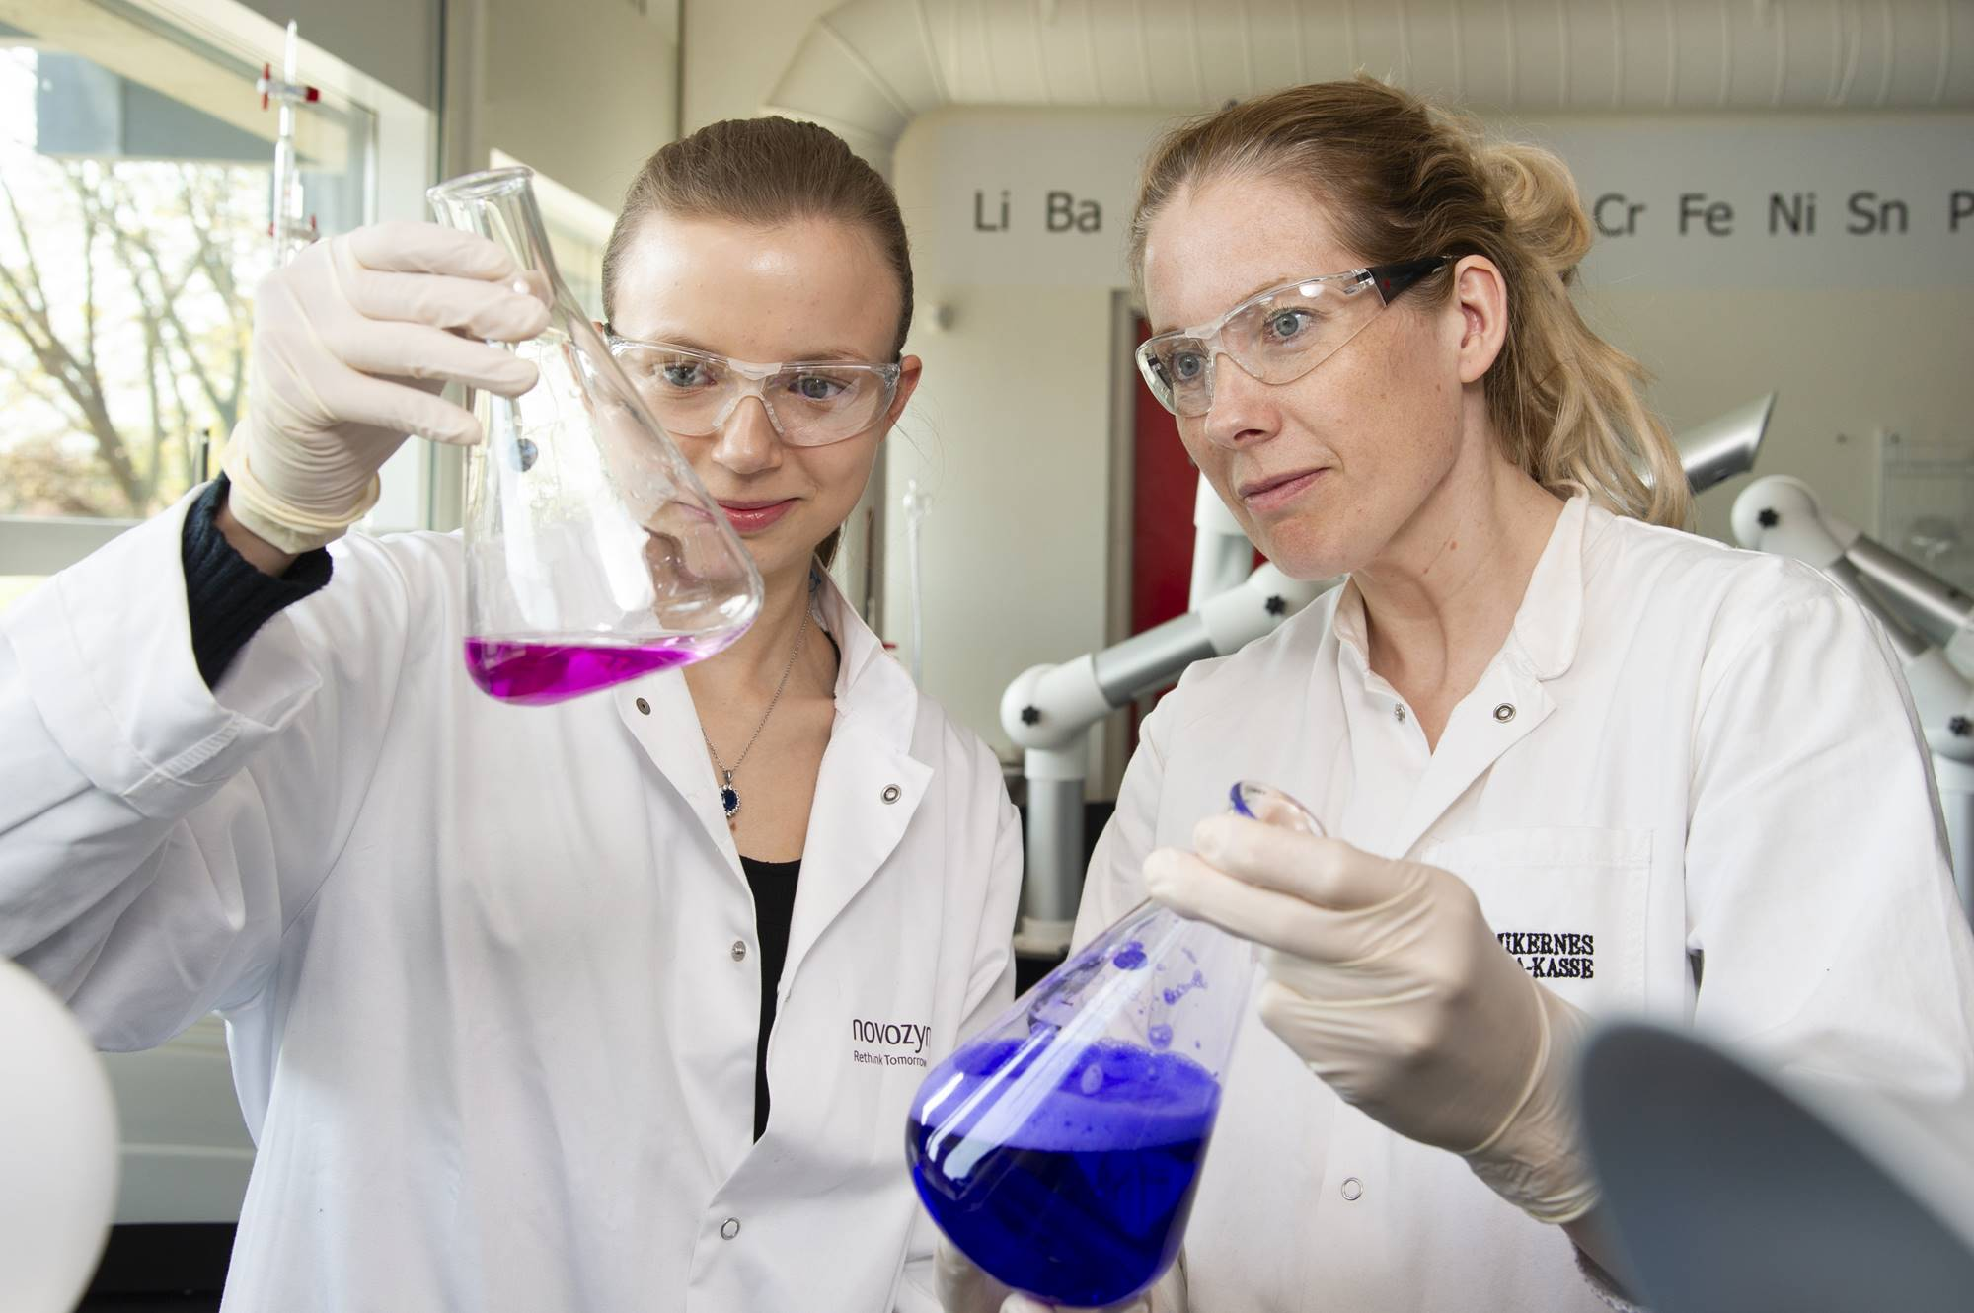
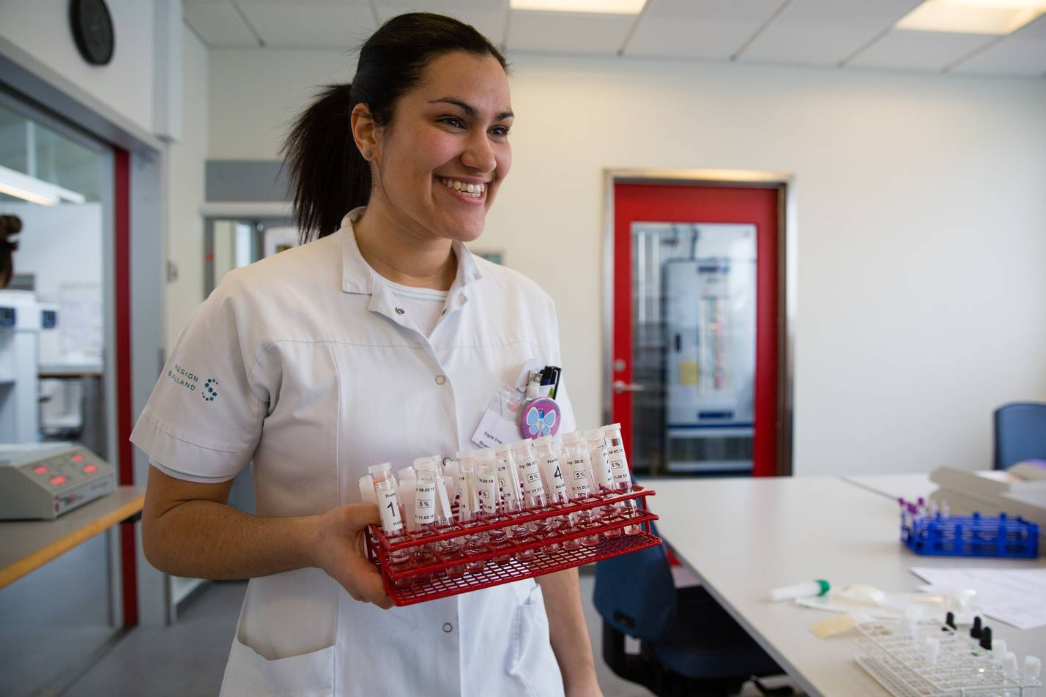
Work attire
Lab coat
Pants
Shoes
Eyes
Contact lenses
Glasses
Safety googles
Hair
Jewelry
Gloves

Slide 6
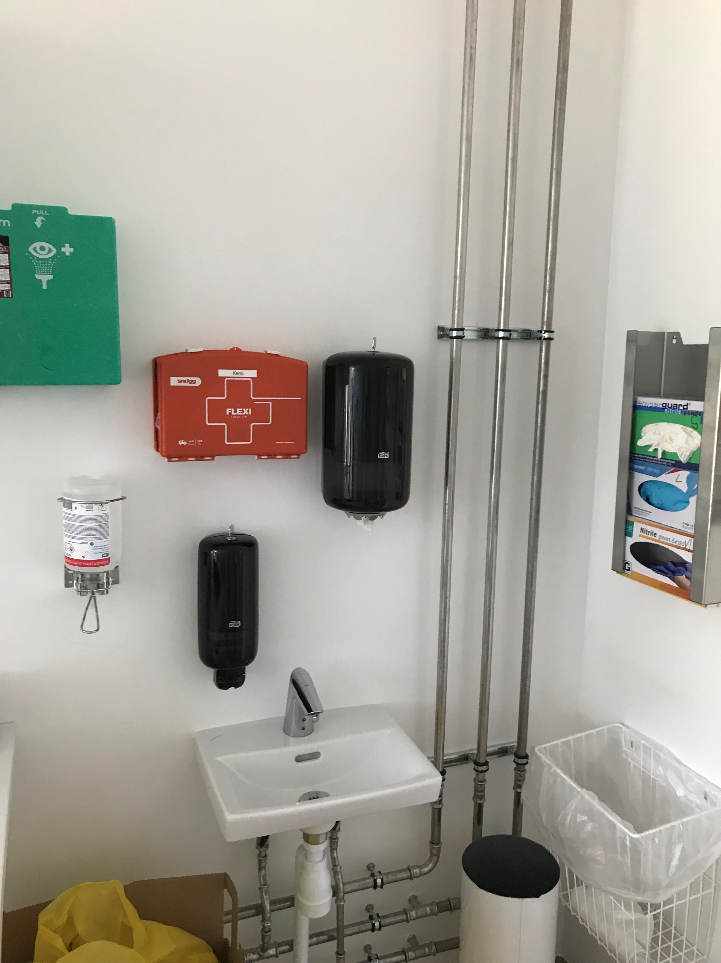
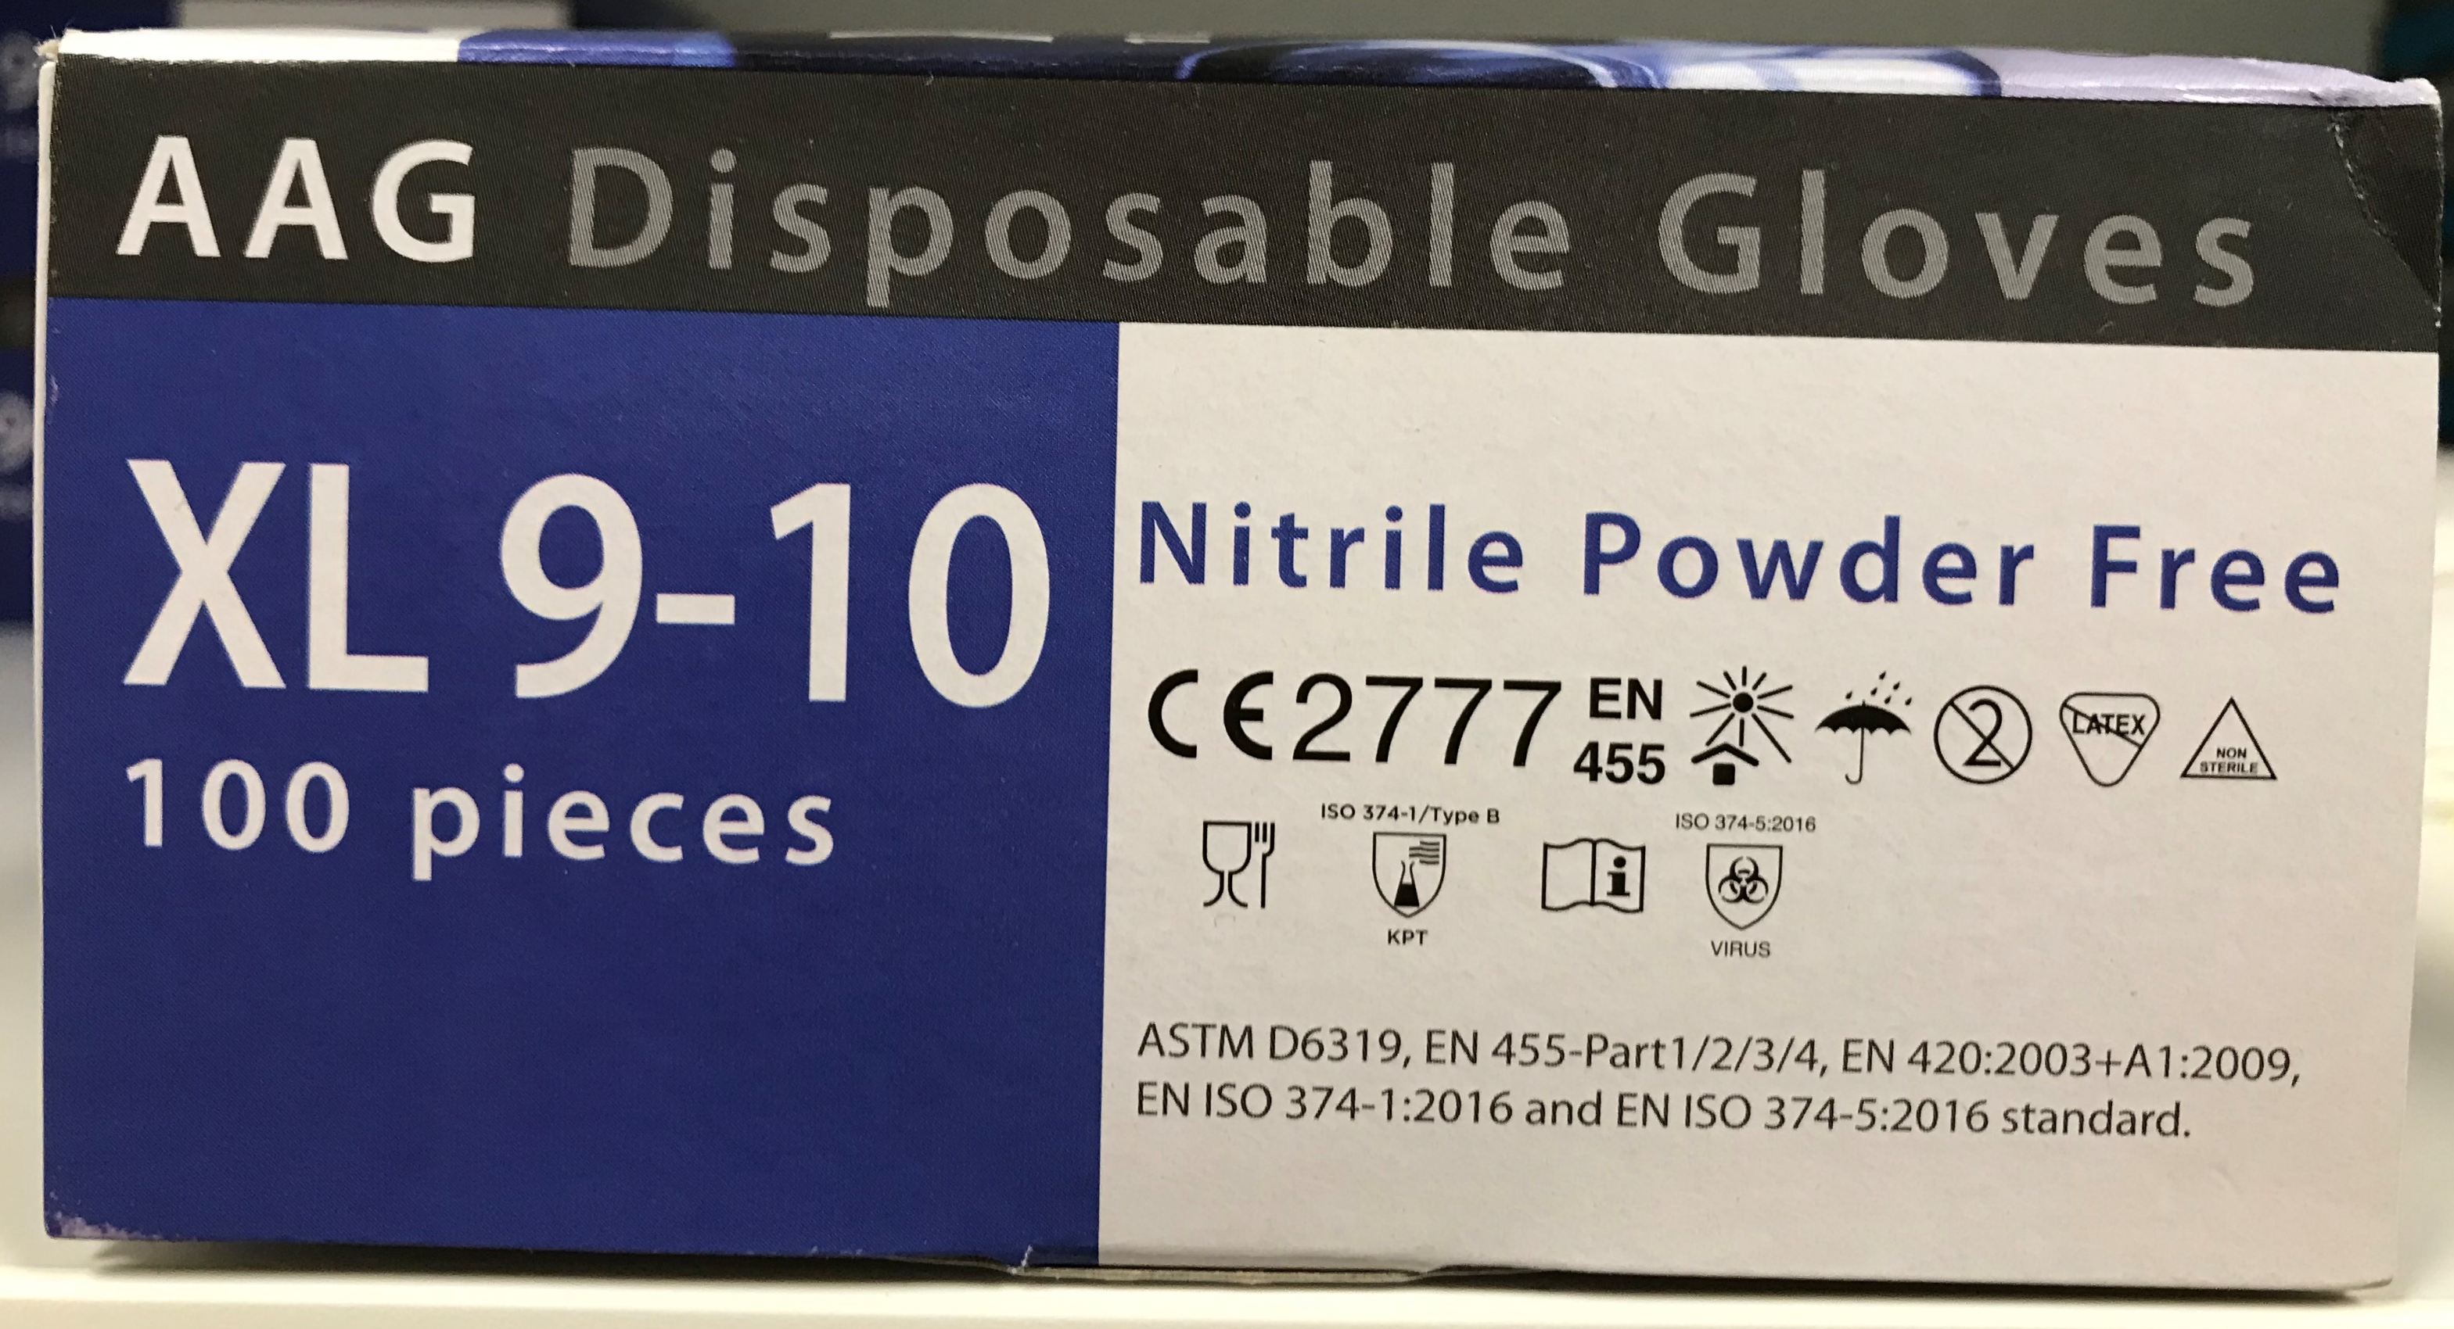
Safety 1
Hand wash (disinfection)
When
How
Gloves
Material, expiration, quality approvals
Secure/ false security?
https://www.youtube.com/watch?v=t2xuszdLRko
Eye wash
Emergency shower
First aid

Slide 7
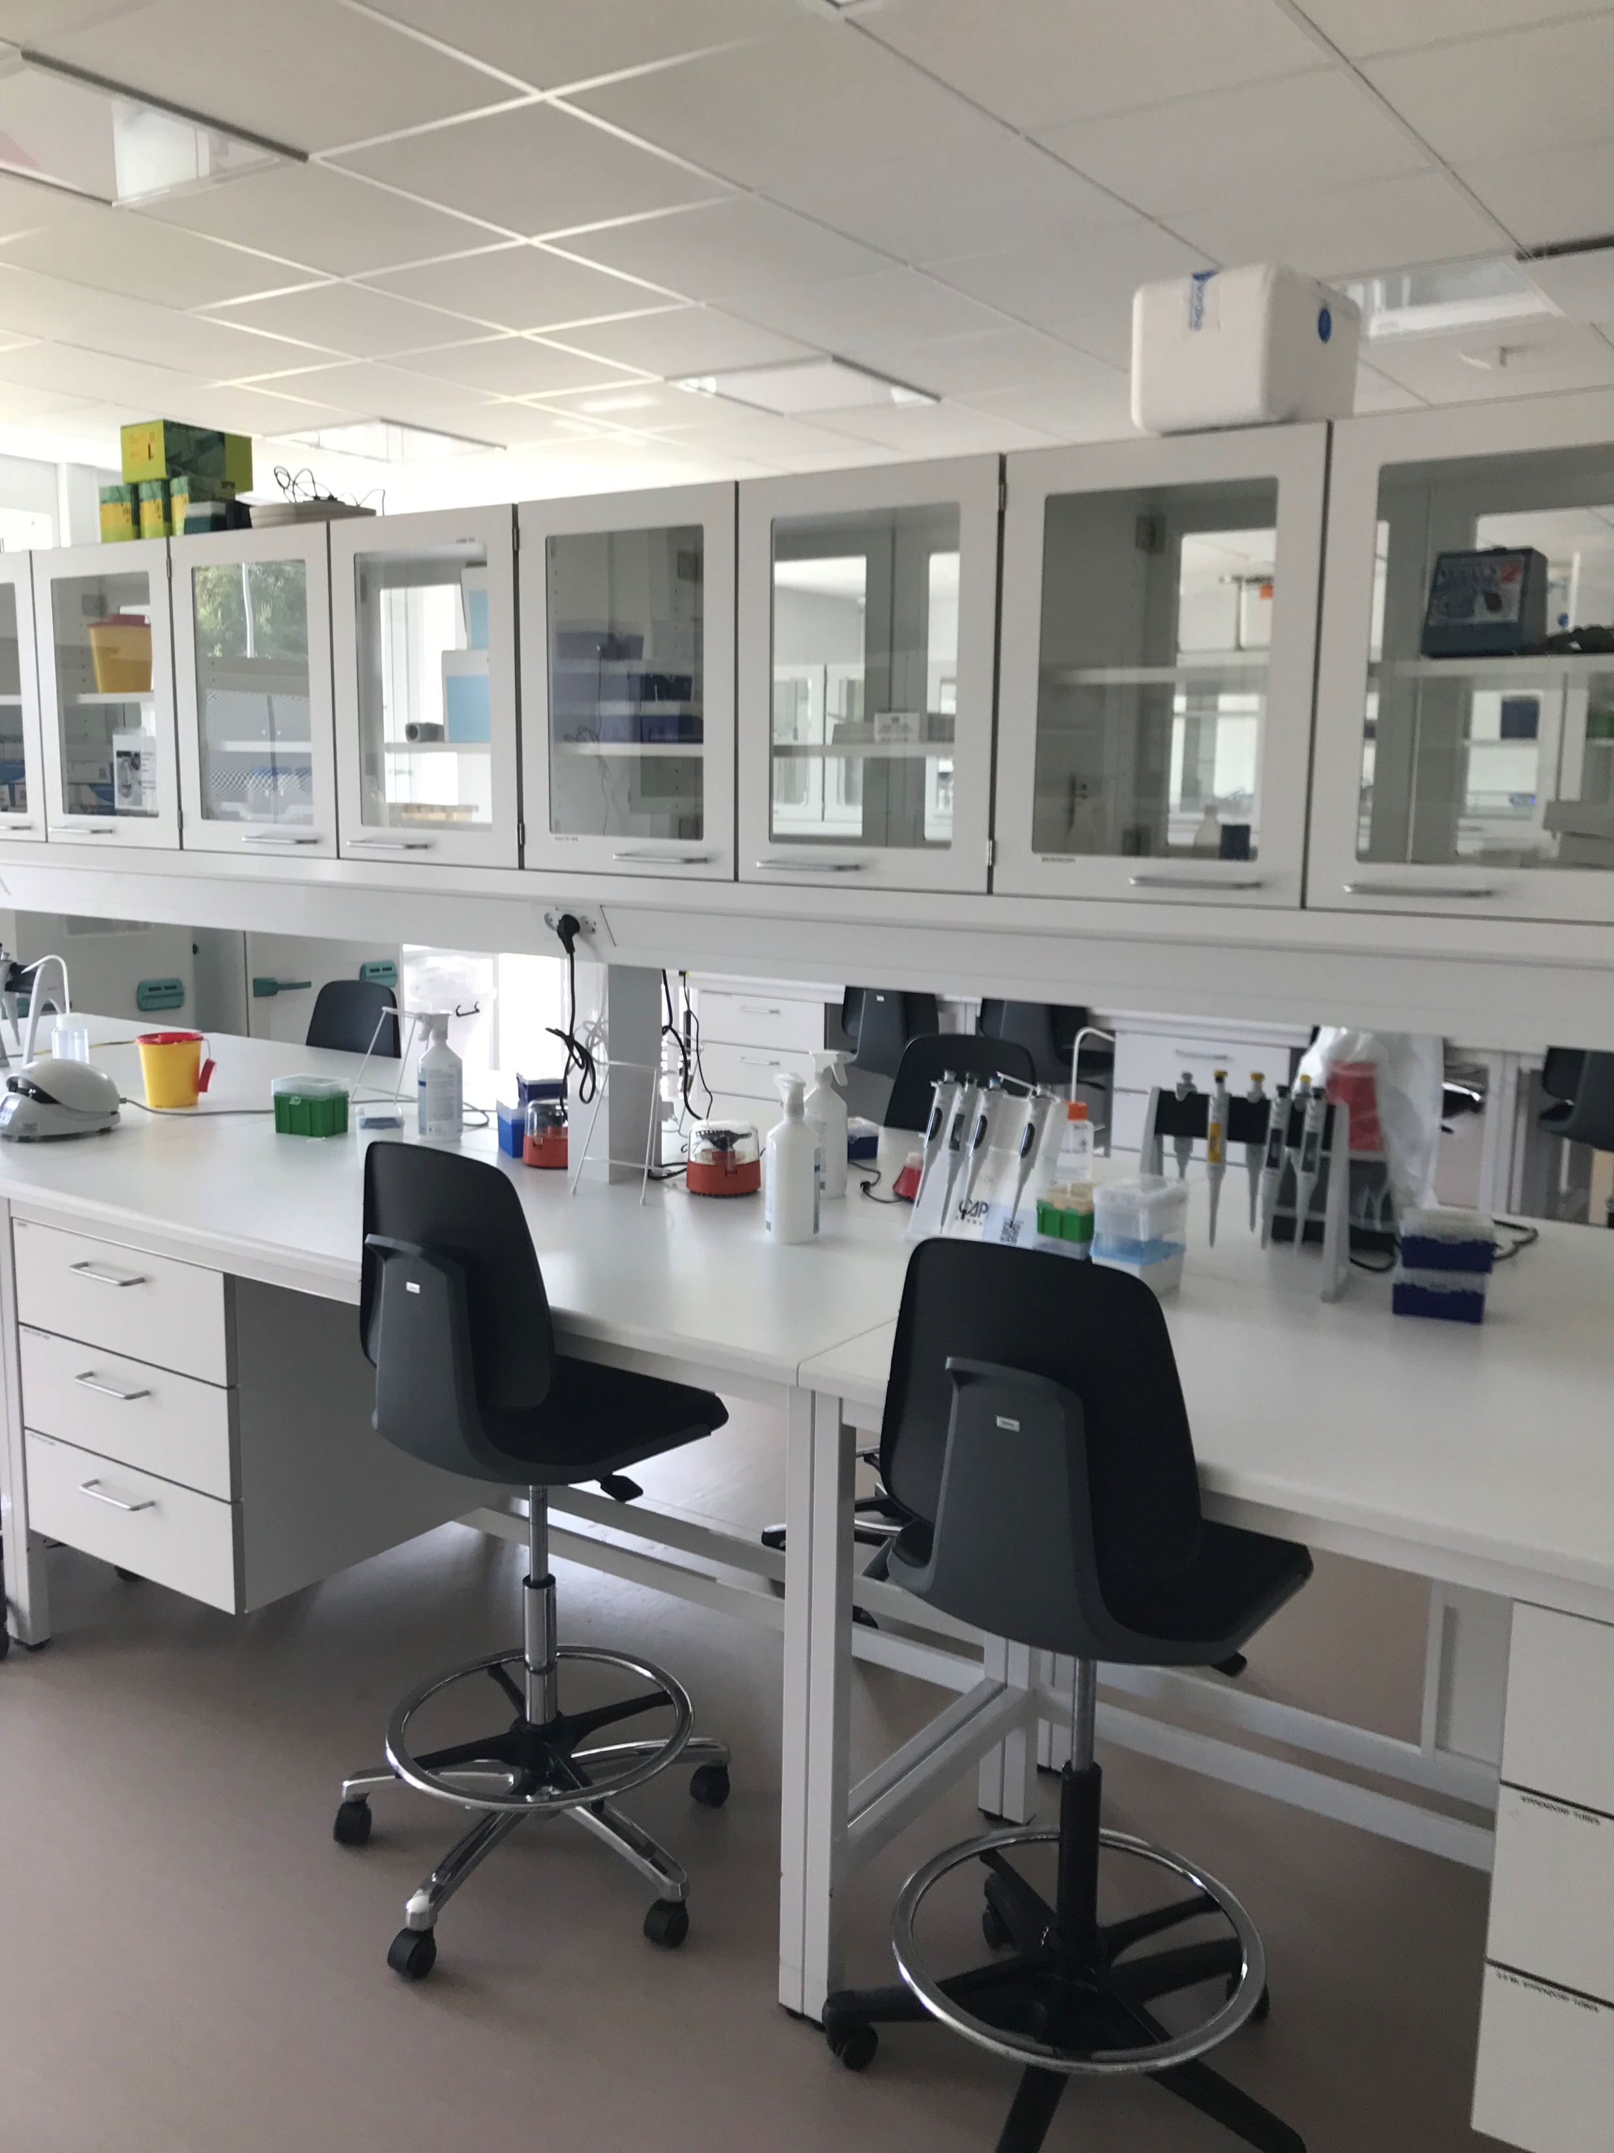
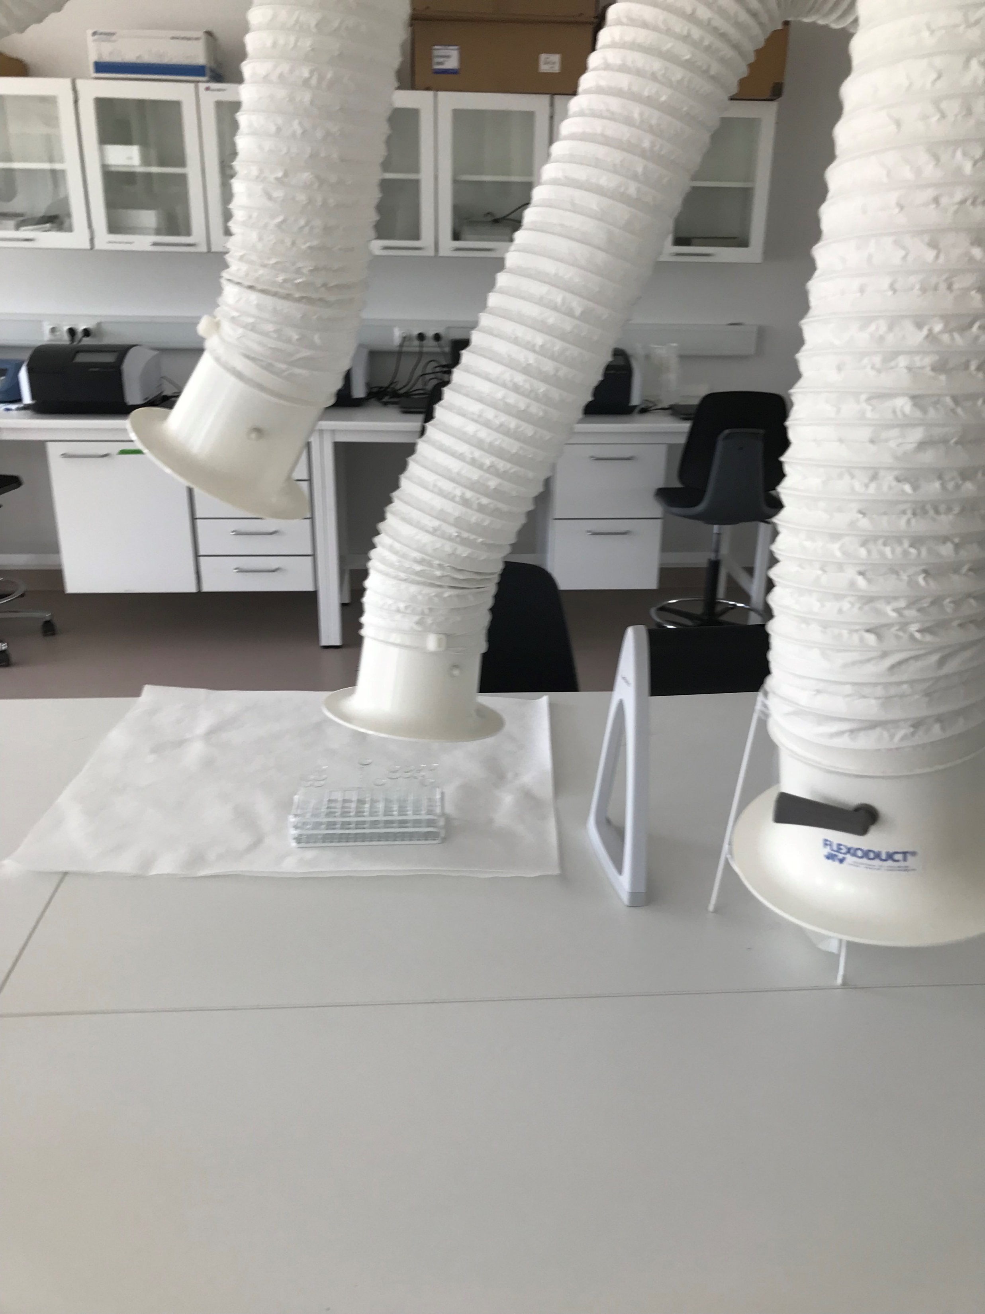
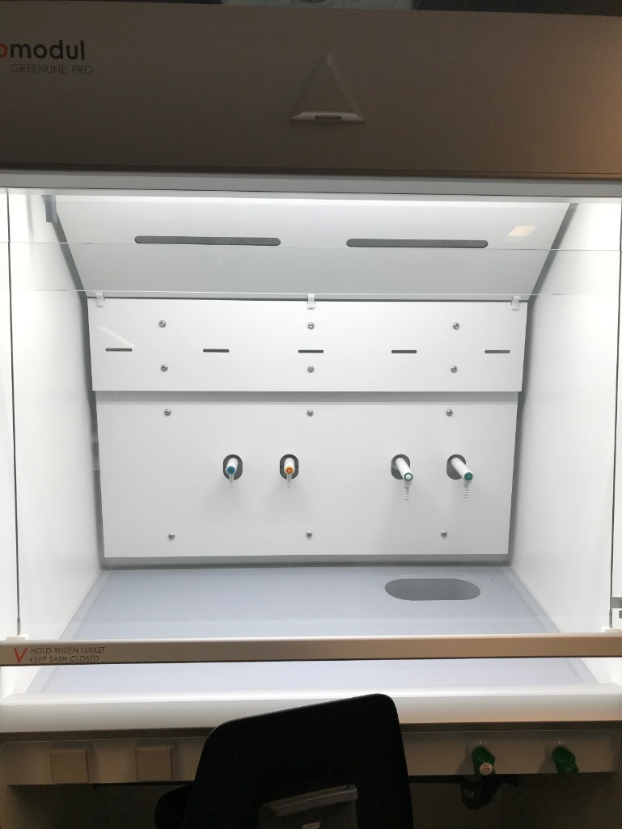
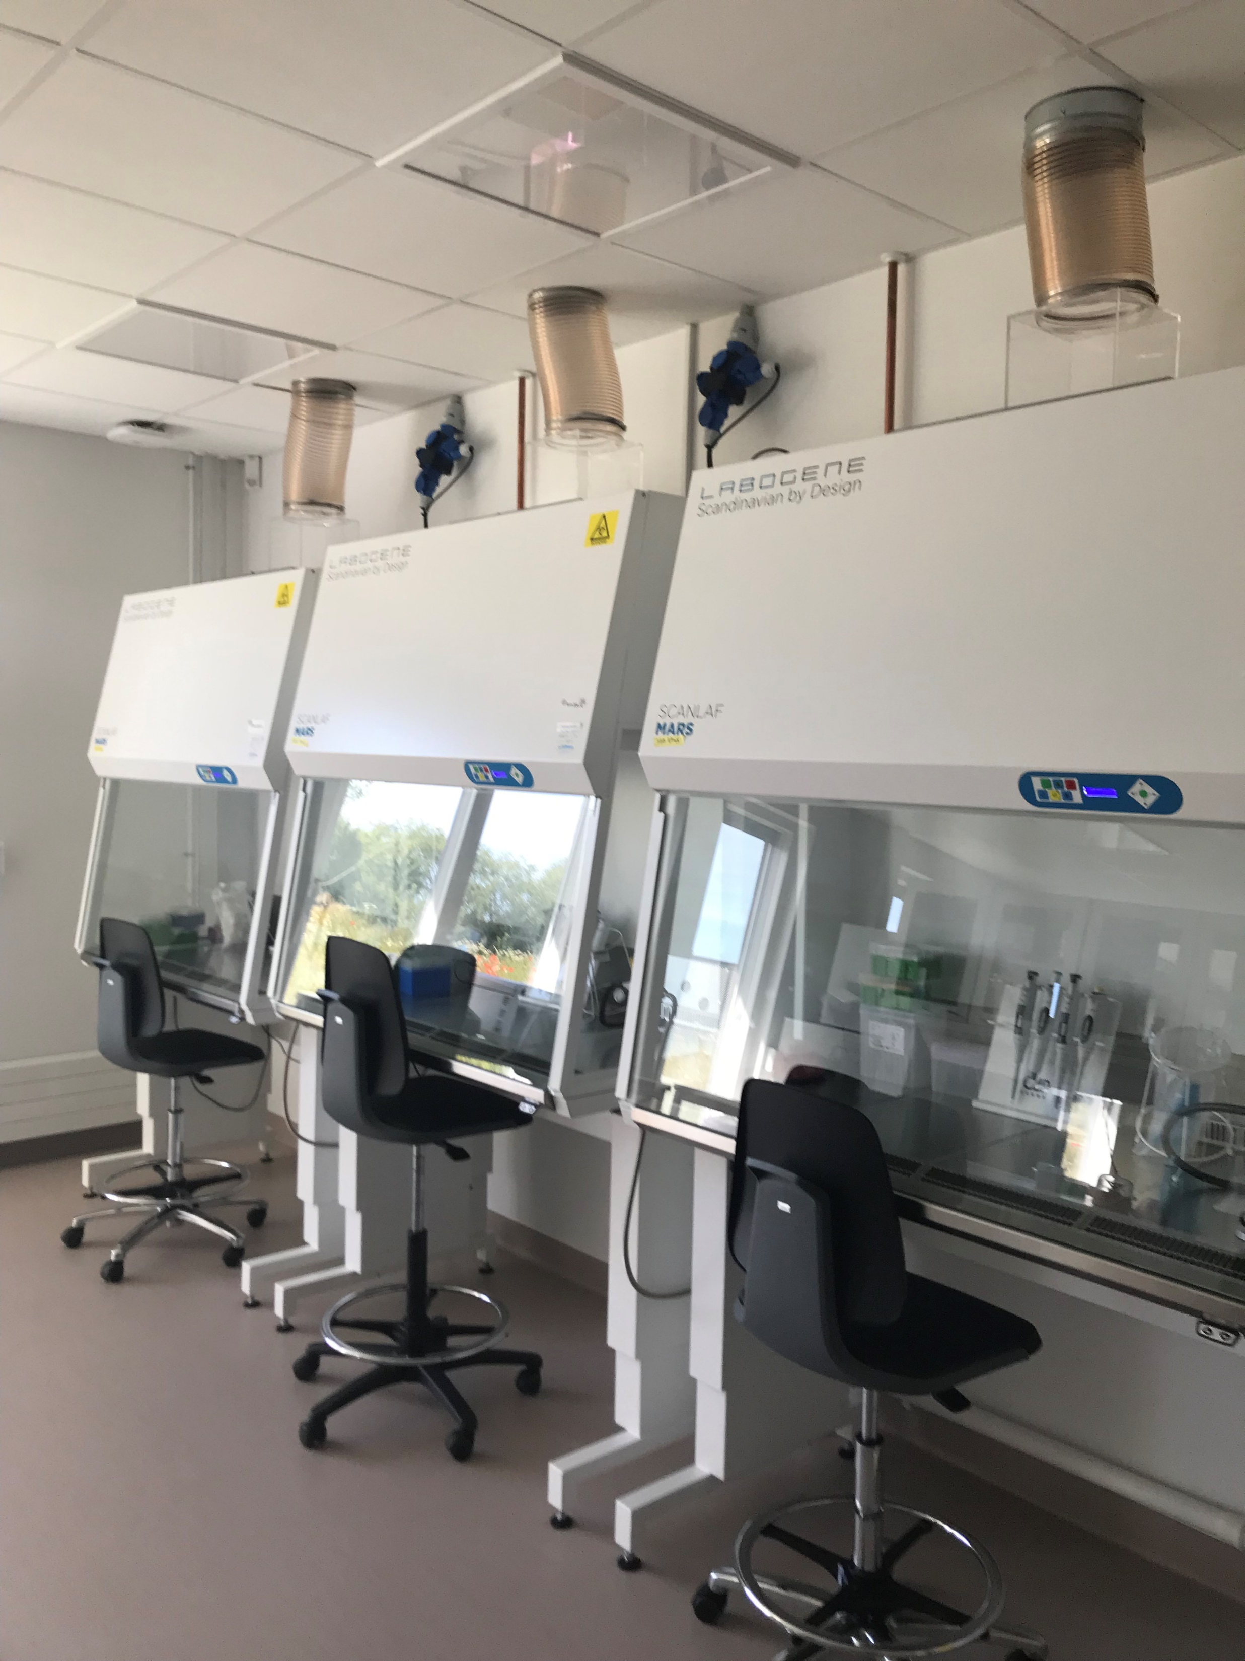
Safety 2
Correct workspace
No suction
Table suction
Fume hood
Safety workbench
Pregnant or breastfeeding is exposed
Inform us as fast as possible
Safety precautions

Slide 8
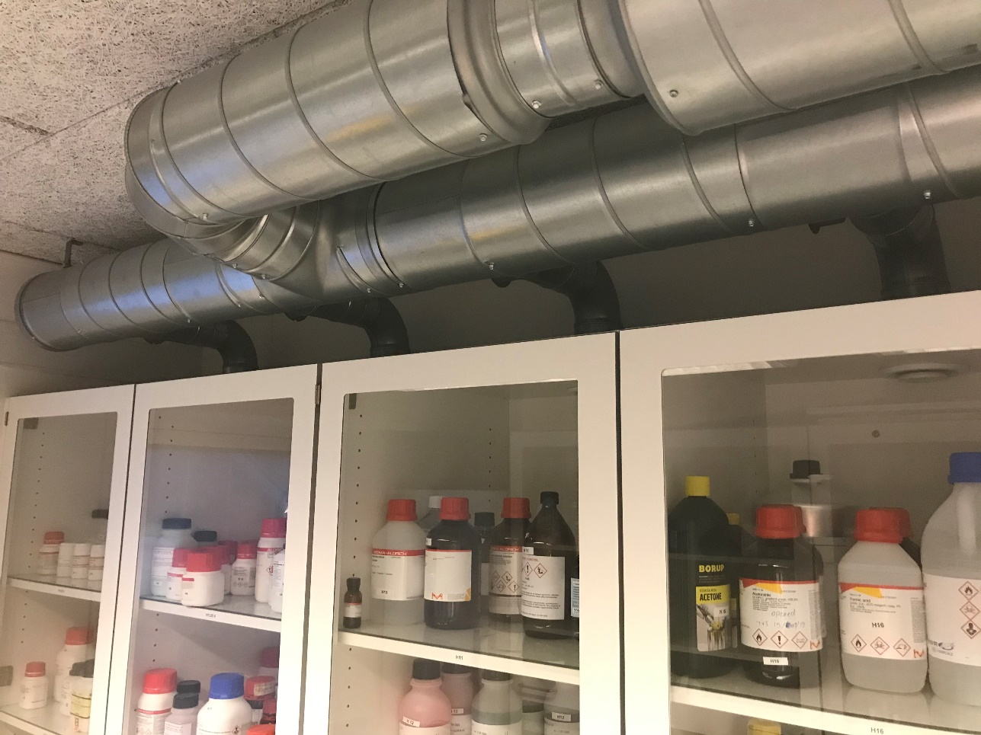
Safety 3
Behavior
Labels
What, when, who (and APB label)
Ergonomics
Using the equipment
Fire sources
Stocks
Protect the label
Stored under suction

Slide 9
Hazard and precaution (GHS)
H/P sentences and pictograms at the European commission’s webpage
Preparation
Examine the regents
Examine the safety precautions

Slide 10
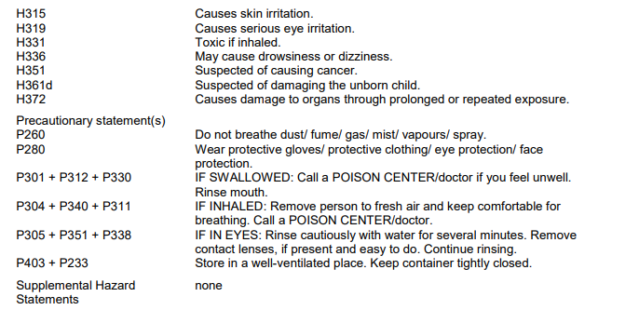
Hazards
Physical/ chemical
H200
Health
H300
Environment
H400

Slide 11
Precautions
General information
P100
Safety
P200
Safety procedure
P300
Storage
P400
Disposal
P500

Slide 12
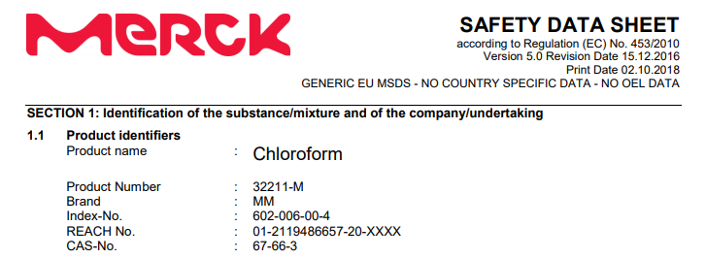
(Material) Safety data sheet
Identification - product & producent
Hazards identification
Composition
First aid measures
Firefighting measures
Accidental release measures
Handling and storage
Exposure and personal protection
Physical and chemical properties
Stability and reactivity
Toxicological information
Ecological information
Disposal considerations
Transport information
Regulatory information
Other information

Slide 13
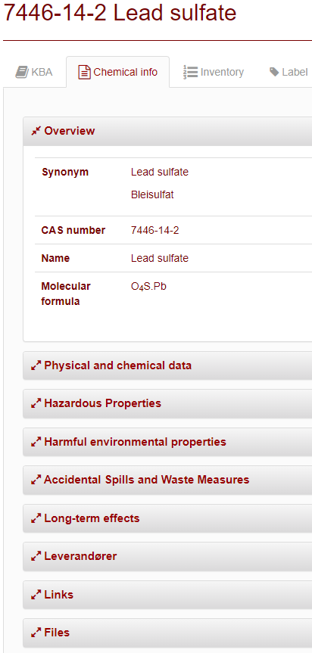
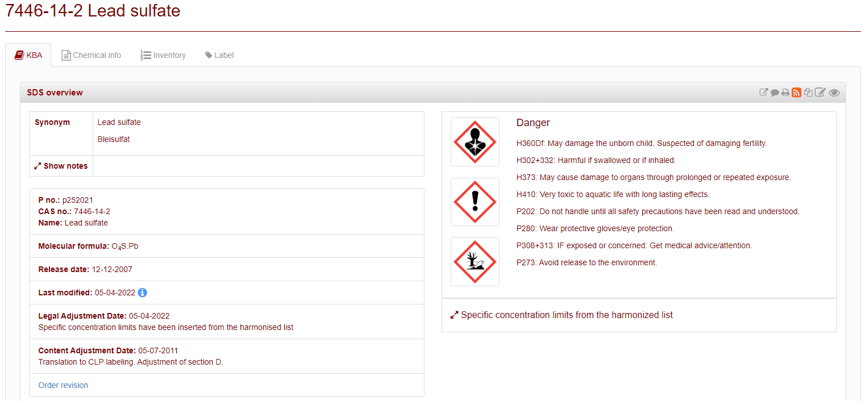
Kemibrug – KBA and chemical info
SDS overview (KBA)
Applicability information
Toxicological information
Exposure and personal protection
Description of the substance
Fire fighting measures
Waste measures
First aid measures
Storage
Substitution
https://www.kemibrug.dk/

Slide 14
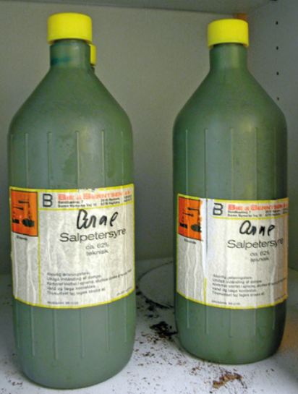
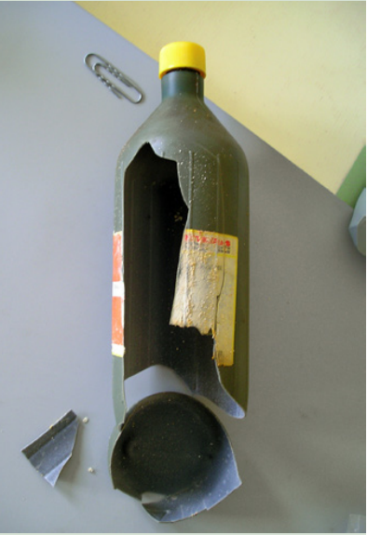
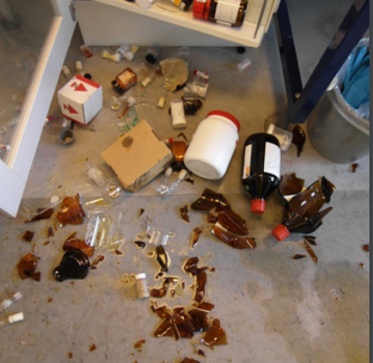
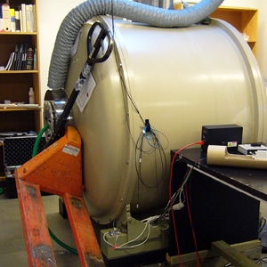
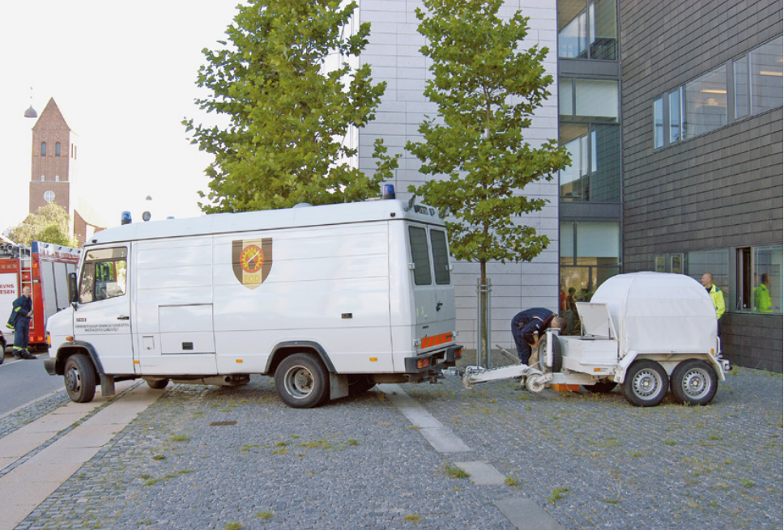
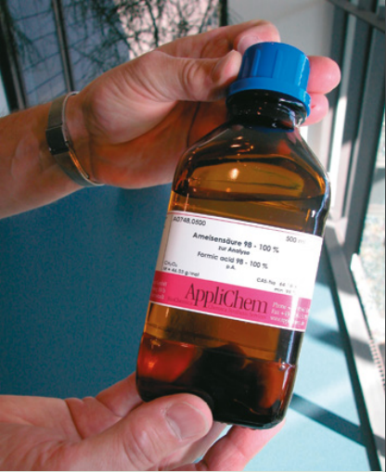
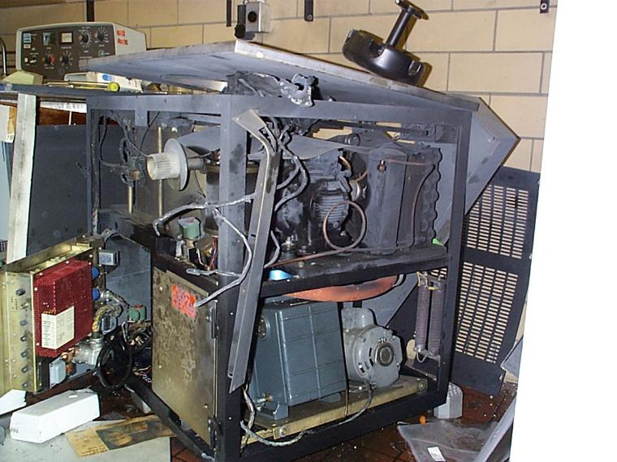
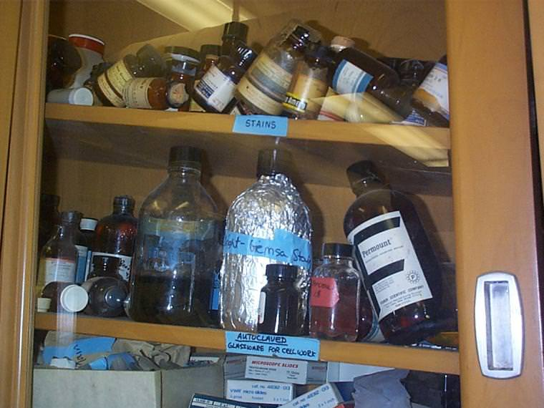
Know the equipment!

Slide 15
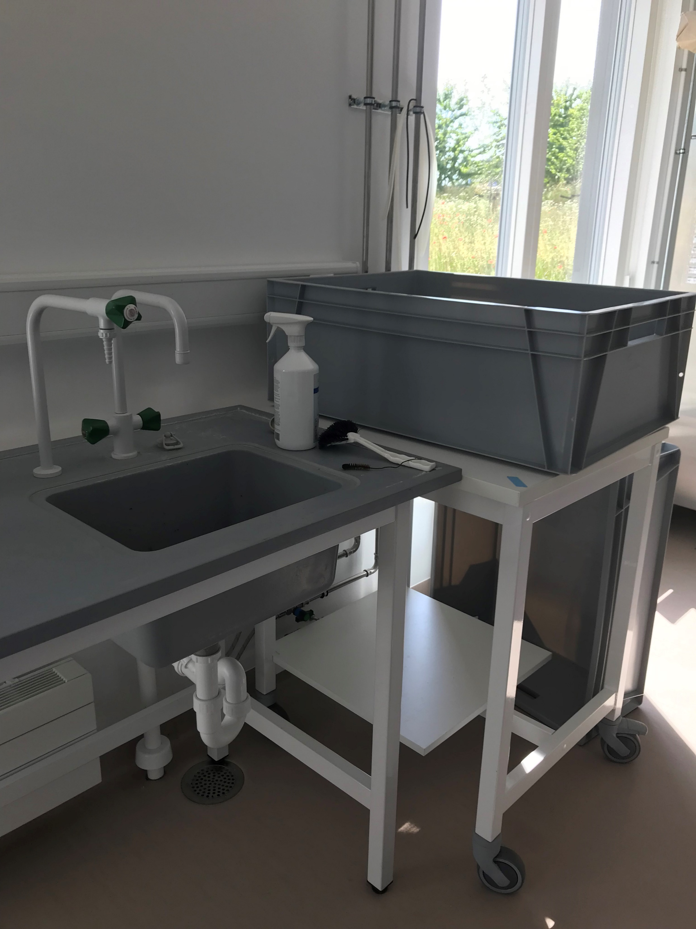
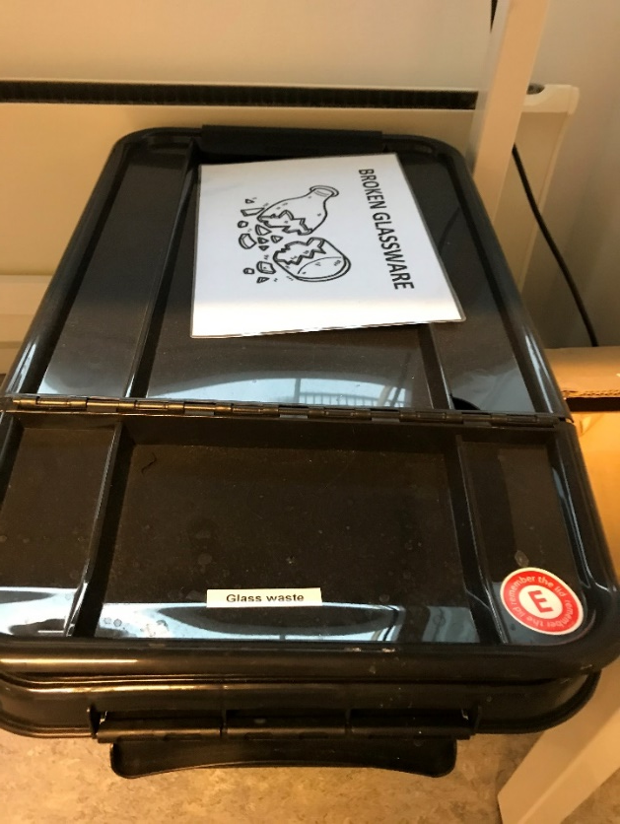
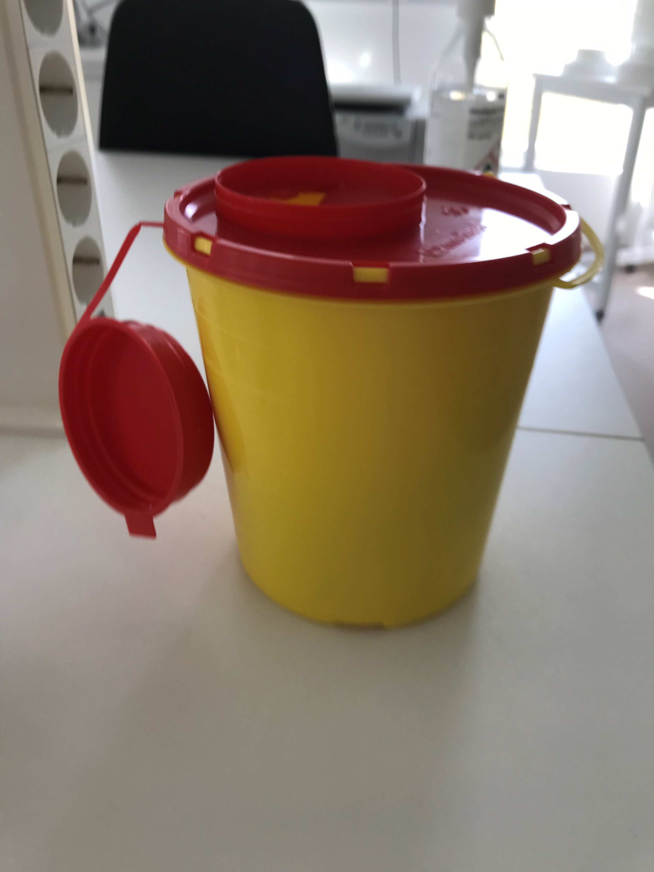
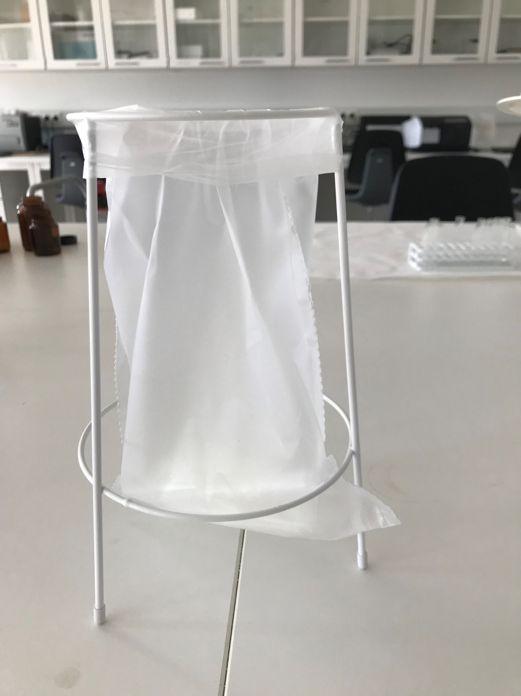
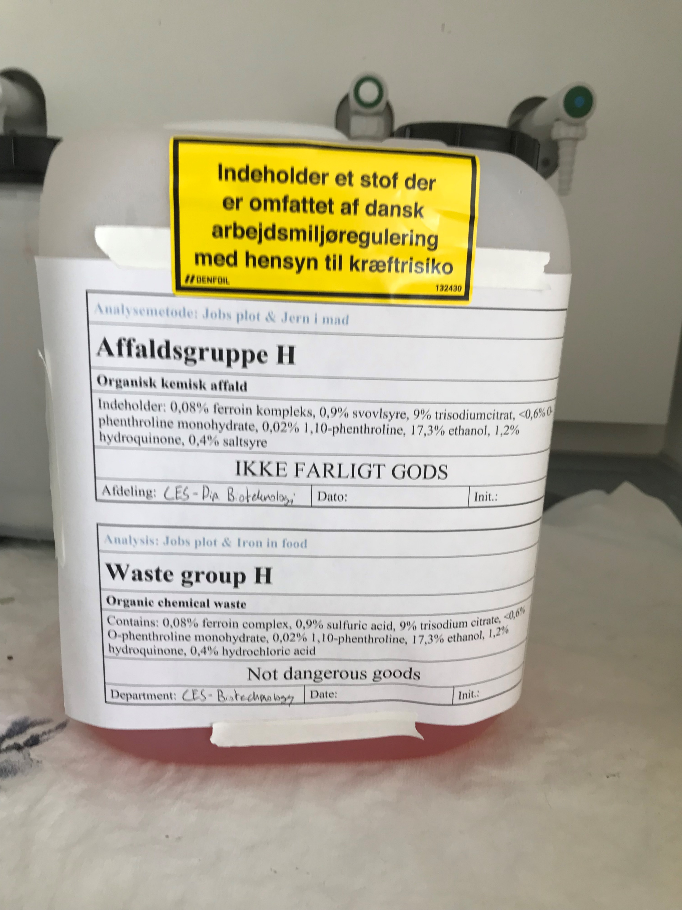
Cleaning
Garbage
Various
Chemicals
Glass
Biological
Cleaning
Laboratory washing
Empty
Rinse off
Ethanol

Slide 16
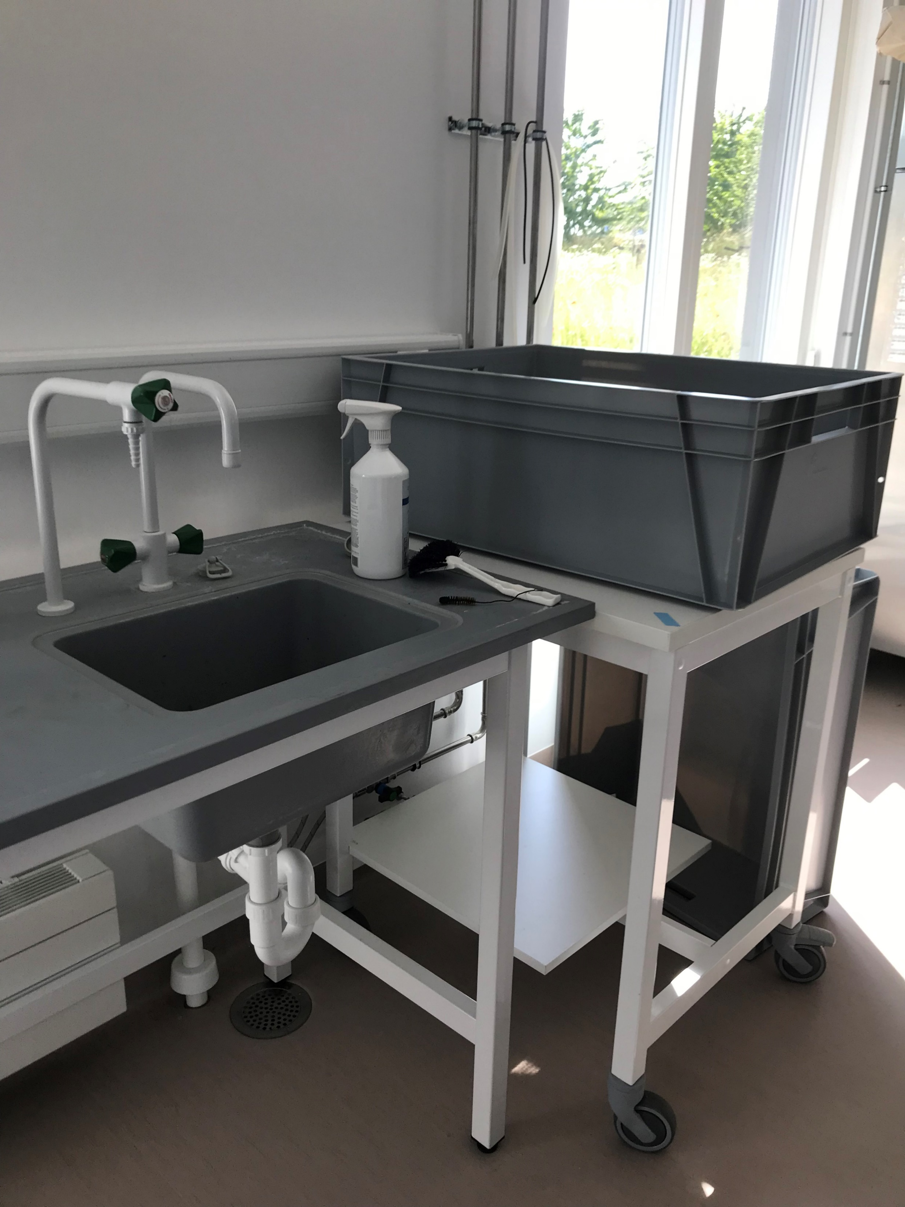
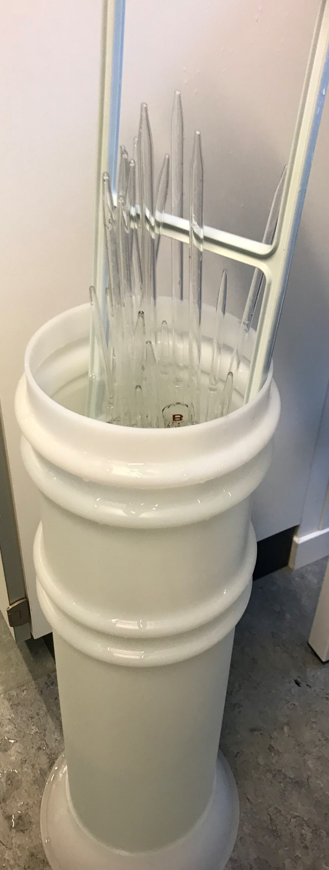
Dirty utensils
Dirty
Empty
Rinse off
Ethanol
Clean
Put in place
Glass pipettes
Tip up!
In the basket

Slide 17
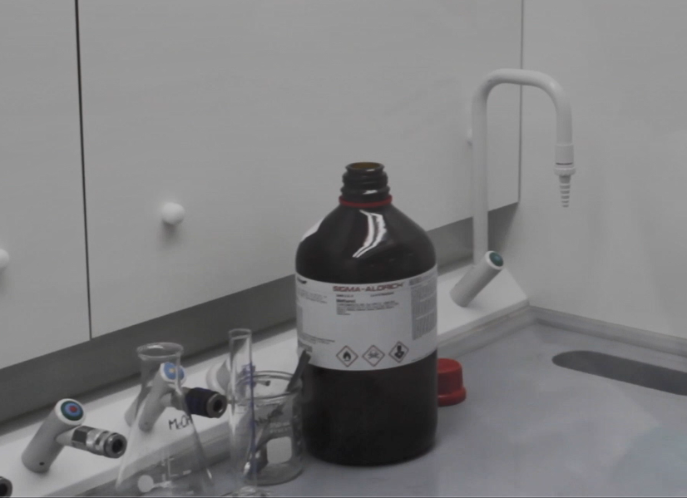
Evaporation
Organic chemistry
Emptied into a waste container
Rinsed with relevant solvent
Water
Ethanol
Acetone
Placed in a fume hood overnight for evaporation
Emptied chemical containers are evaporated as well

Slide 18
Chemical waste groups
Group | Short description | Examples
O | Strong oxidizing agents and agents that react violently with water | Hydrogen peroxide, aluminum chloride
K | Contains mercury | Mercury batteries, mercury thermometer
Z | Packaging, medicine and batteries without mercury | Clinical waste and waste not suitable for other groups
T | Pesticides – Under normal circumstances not found in a lab | Toxins, pesticides
X | Inorganic substances | Acid, base, metal, salt
A | Minerals not containing emulsifiers – Under normal circumstances not found in a lab | Types of oils
B | Sulfur, fluorine, chlorine, bromine or iodine | Chloroform, PVC, sulfur
C | Liquid flammable agents (>18MJ/kg) | Acetone, ethanol, xylene
H | Organic waste with a high water content | Formalin, acetic acid, organic salts and acids

Slide 19
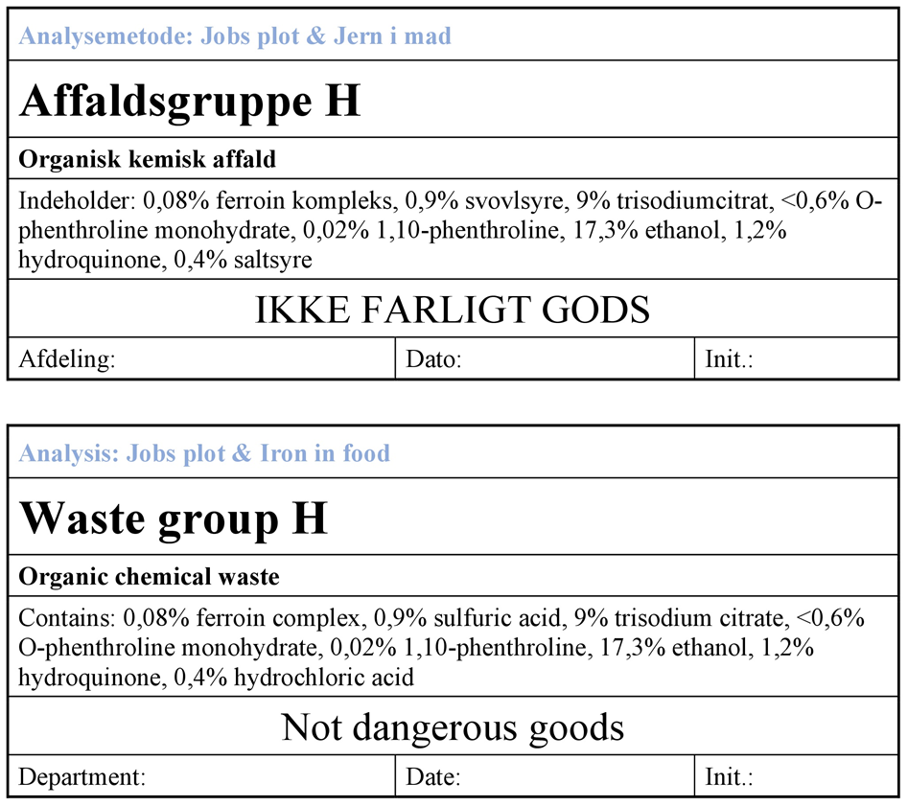
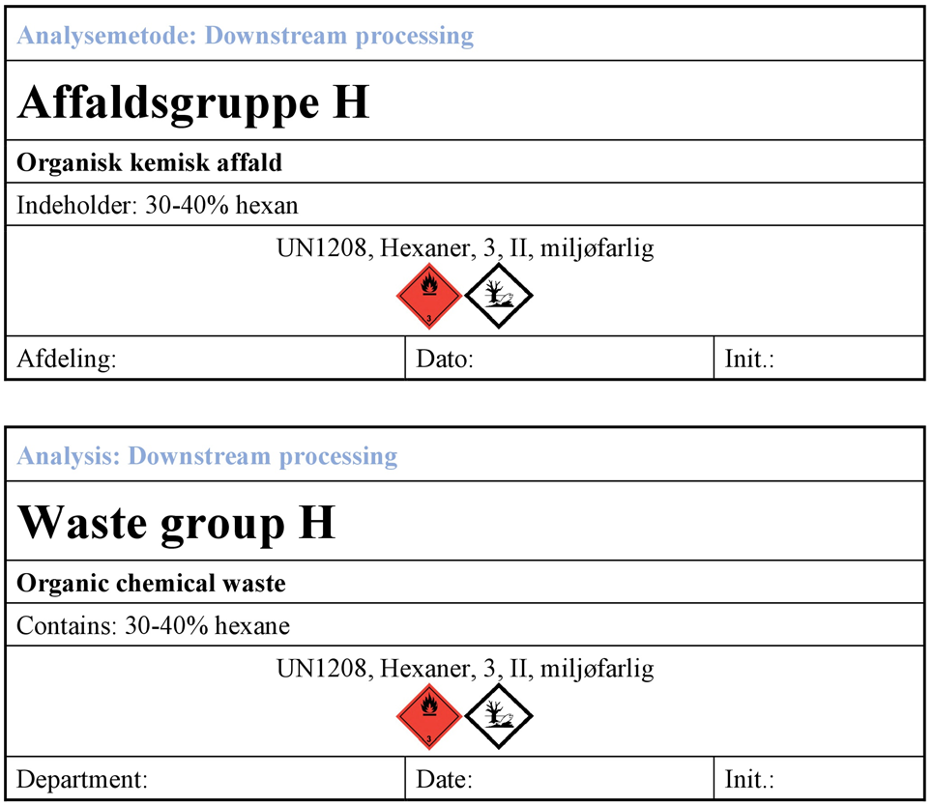
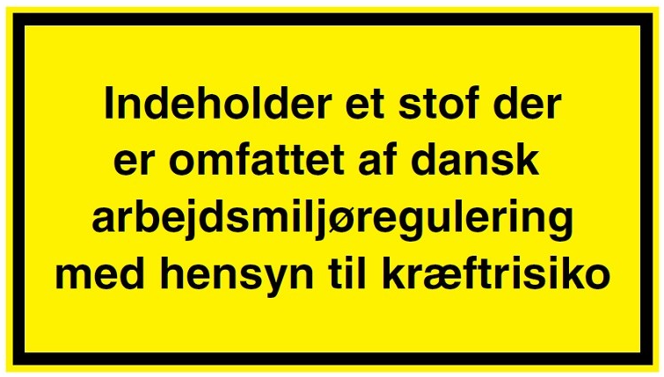
Waste containers and labels
Plastic- or glass container?
X, Y,Z / I , II , III?
Ventilated lid?
Transport (ADR) – Who is allowed?
UN-number
Labels
Chemical waste
H350,H350i and H351
Contains agents which is regulated by the Danish work environment regulation regarding carcinogenic agents

Slide 20
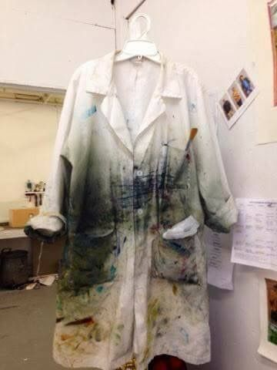
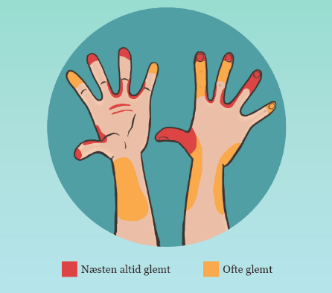
After lab
Handwash
Lab coat
Dirty
Wash
Always forgotten
Often forgotten

Slide 21
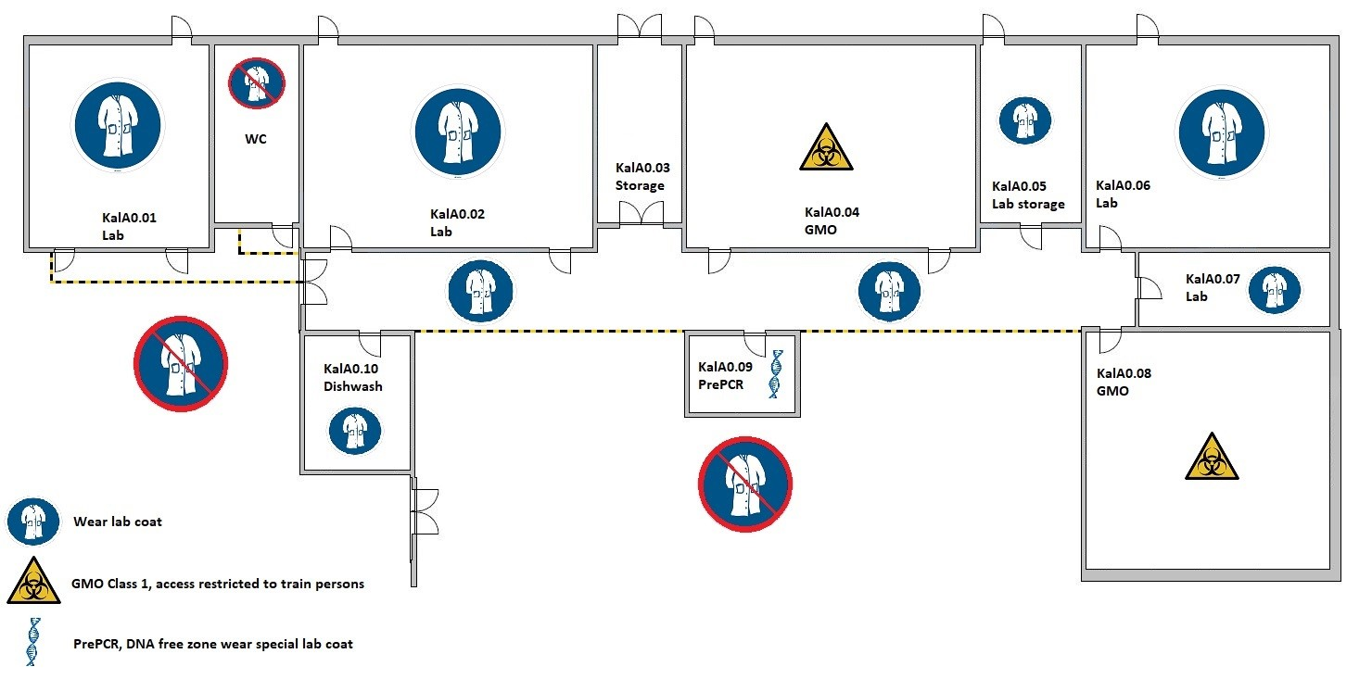

Slide 22
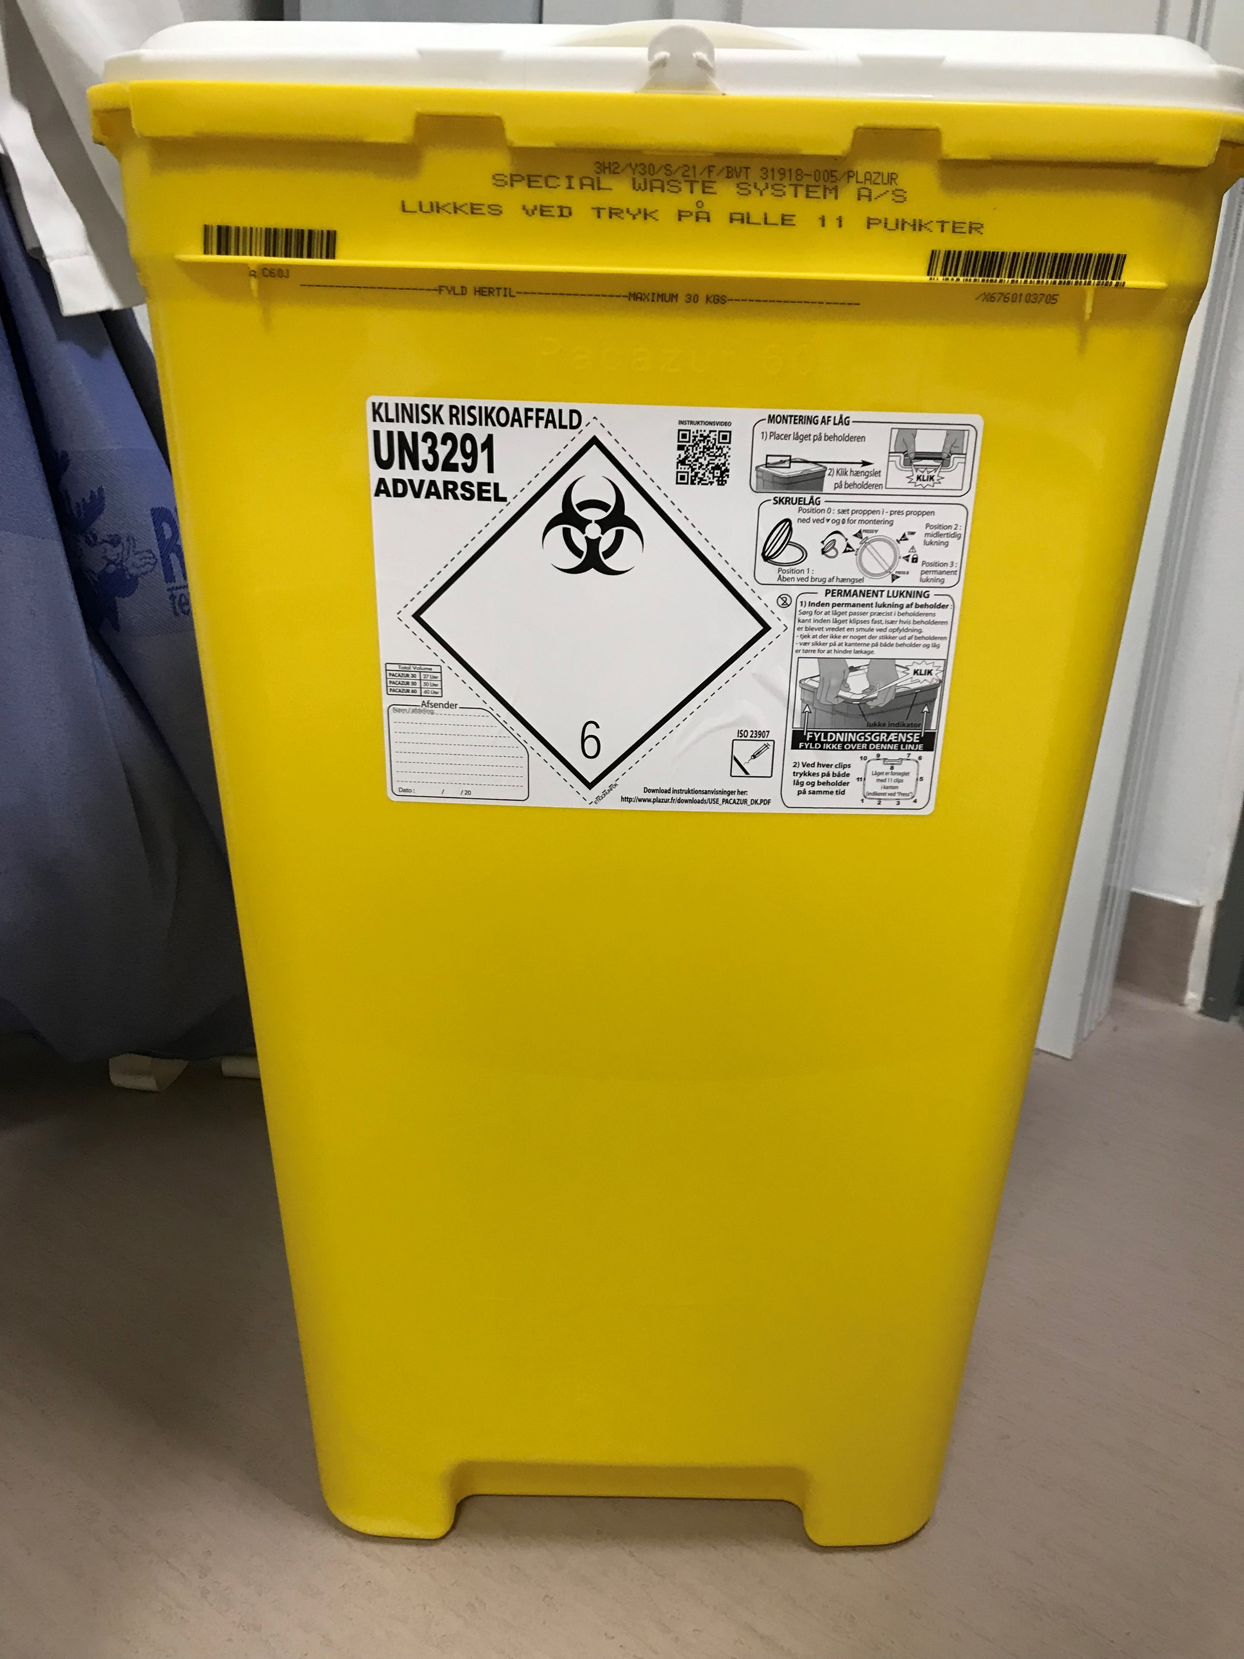
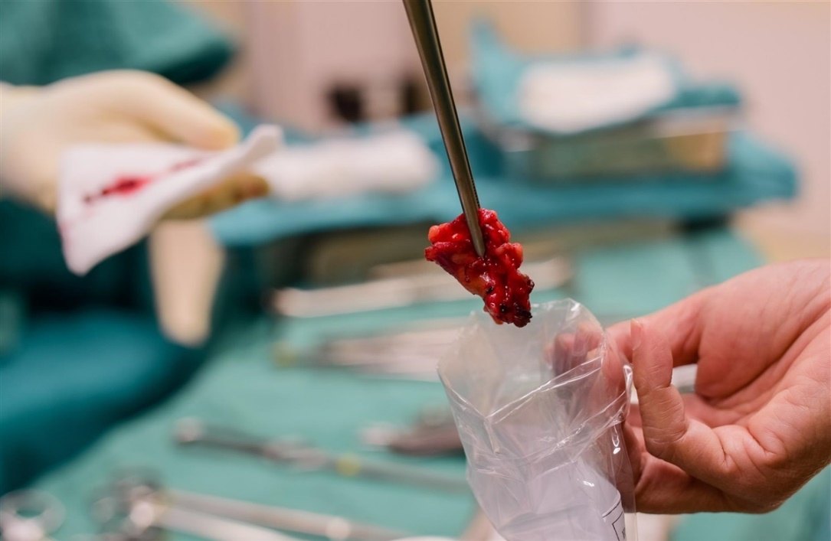
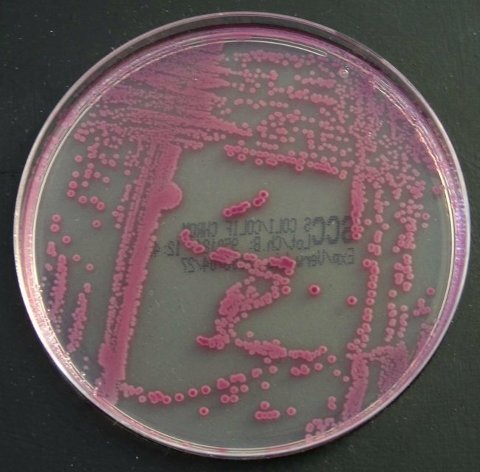
Biological laboratories
Risk
Treatment
Hygiene
Hand wash
Disinfection
Lab coat
Cleaning
Disposal

Slide 23
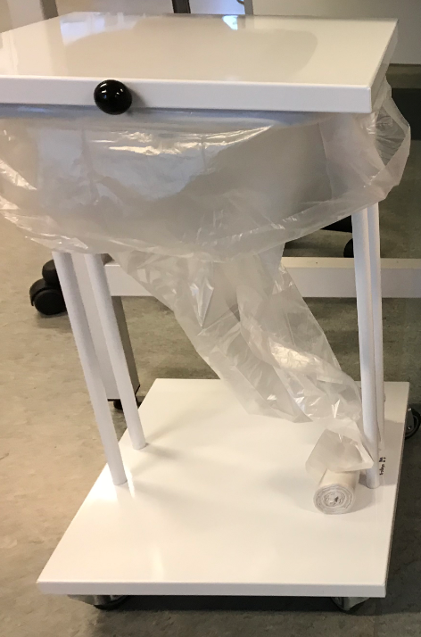
Sorting biological waste
Biological waste from GMO class 1 (solid) Biological waste from biological agents class 1 and 2 Human material – Tissue Needles, slides and other sharp objects | Clinical waste
Biological waste from GMO class 1 (Liquid) | Decontaminated and poured into the sink
Biological waste from GMO class 2 Biological waste from biological agents class 3 | Autoclaved
Uncontaminated packaging and utensils Autoclaved waste | Daily renovation

Slide 24
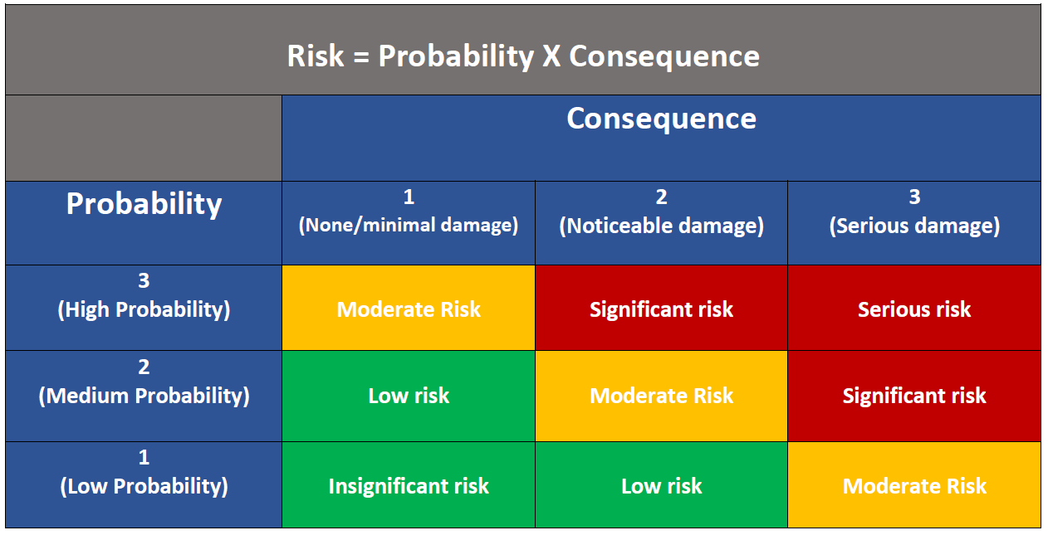
Risk assessment
Be prepared !
Methods
Risk
Chemicals
Risk
KRAN -> “CRAN”
Substitution
CAS-kemibrug
Cleaning
Waste / CAS-kemibrug
Points of attention/ actions

Slide 25
Good advice
Never pour water into concentrated acid!!! – Slowly pour the acid into the water while stirring.
Always turn the reagent tube opening away from yourself and other. Point it towards the back of the fume hood, it prevents splashing on people.
Sealed flasks or other glassware may never be heated due to the change of explosions.
Centrifuges is used according to the manual, always remember balancing the tubes.
Glass tubes may never be forced though a hole in a lid without knowing the right procedure!
Rube hoses that cannot be easily removed is cut off near the glass.
Vacuum equipment must be placed into a fume hood, if possible, due to the risk of implosions.
Dangerous chemicals (Toxic, corrosive, flammable) in glass flasks containing more than 1 liter, must be transported with curation, e.g. use a plastic container with a handle.
Fire may only be used where directed.
Flammable/explosive liquids and solids may never be used near fire – When heating use an electric heating plate / jacket.
Never pour chemicals back into the stock. Excess chemicals is treated as waste.
Liquids spills on stock bottles is rinsed with water and the bottle is wiped with tissue.
Chemicals is put back in their place immediately after use.
Solutions, you have created, must be labelled clearly! Contents, signature, date and pictograms.
Glass with abrasive (e.g. funnels) must be lubricated with silicone or a Teflon ring before use- Important when using bases.
Workspaces is kept clean and organized, utensils that are not in use in the current setup is kept at a distances – including laptops, notebooks etc.
Always handle a stock bottle by the label when pouring, this protects the label and prolong the lifespan.

