Slide 1
”How to prepare for lab”
Majbrit Madsen
Version 1 from 22. august 2023

Slide 2
Why do we prepare for lab?
To know what to do
If there is a specific order to perform the experiment
If there is a specific technic to understand
If there is something to be aware of regarding safety
If there are anything to prepare (calculation, buffers, etc.)
If there are a specific thing to remember to note during the experiment
To ensure safer and well executed experiments
Version 1 from 22. august 2023

Slide 3
How to prepare for lab?
Read the protocol/manual
Understand the purpose of the experiment, what are you aiming to prove/find?
Look up all the abbreviations or word you do not understand to ensure that you know them
Make a flow diagram
To ensure that you understand the steps and orders and what to use
Helps you during the experiment to know what to do next
Preparation prior to start the experiment
Prepare document to conduct the experiment
Prepare equations & calculations
How to obtain the needed concentration (how much to weight out)
What dilutions is needed (how to do the dilution)
Version 1 from 22. august 2023

Slide 4
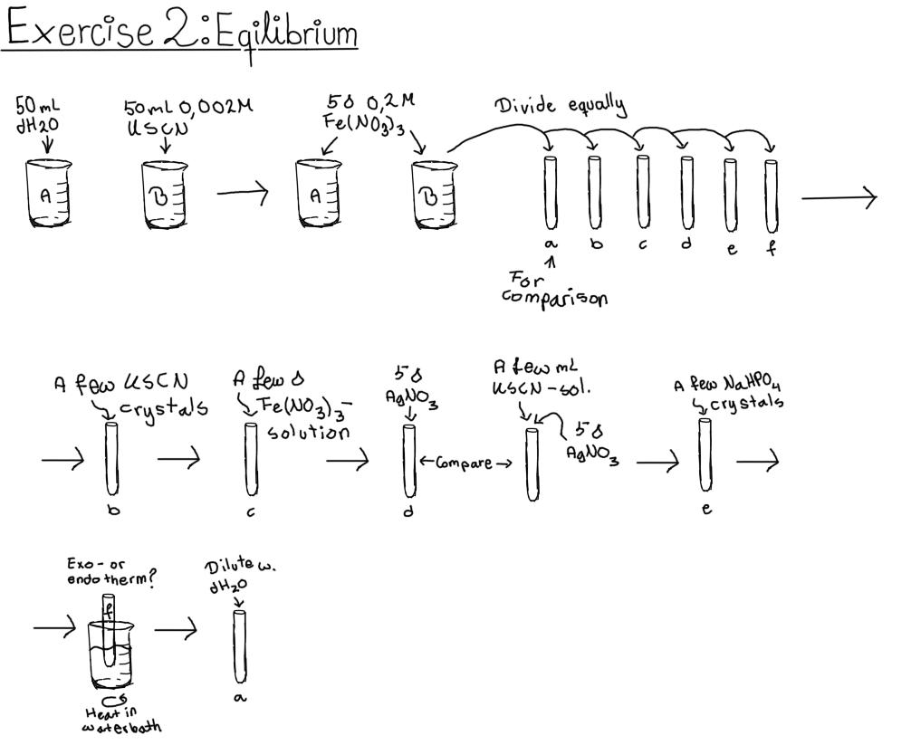
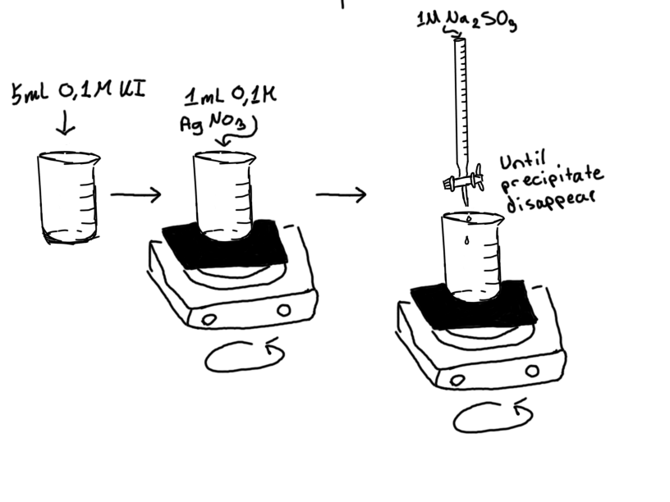
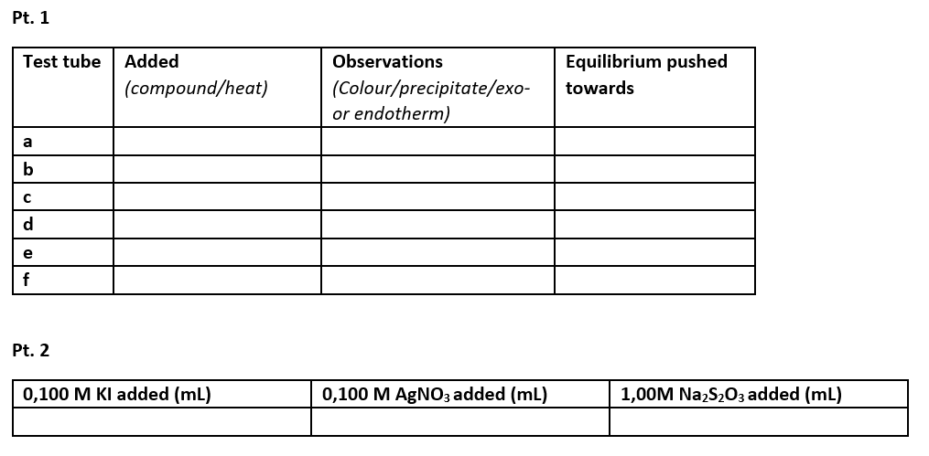
Example of flow diagram - 1
General and organic chemistry:
Equilibrium
Part 1:
Example for scheme to document results:
Part 2:
Version 1 from 22. august 2023
Angela Kristiansen

Slide 5
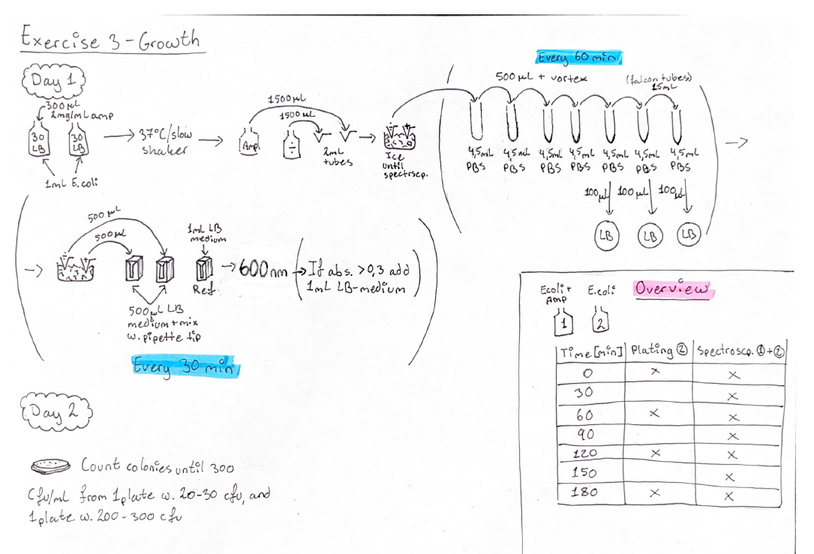
Example of flow diagram - 2
Microbiology:
Growth of E. coli measured by spectrophotometer & plate count
Prepared excel scheme to document the experiment Day 1. Including calculation of ln and plot with linear regression.
Results form spectrophotometer:
Time [Min] | E.Coli + AMP | E.Coli
0
30
60
90
120
150
180
Materials:
Spectrophotometer type: ____________
Incubator used: ____________
Version 1 from 22. august 2023
Angela Kristiansen & Majbrit Madsen

Slide 6
Example of flow diagram - 3
Biochemistry: SDS-page
Version 1 from 22. august 2023
Majbrit Madsen

Slide 7
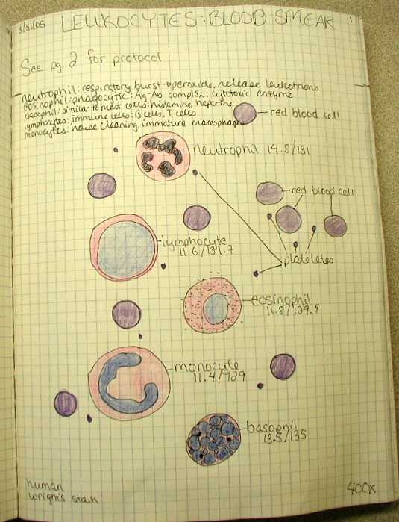
”How to labbook”
”How to avoid meaningless lab-work”
Kresten Jon Korup Kromphardt
Kim Blanksø Pedersen
Version 1 from 22. august 2023

Slide 8
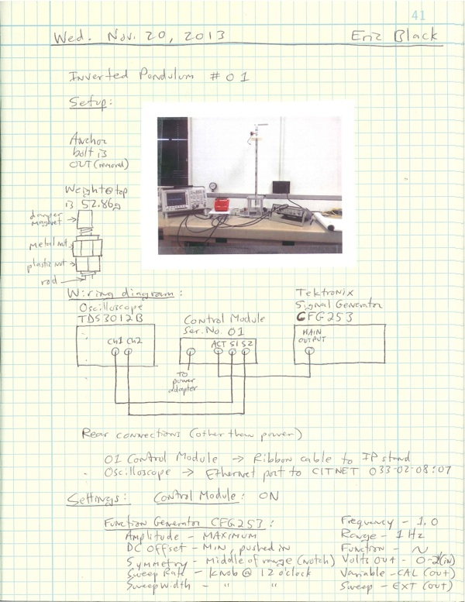
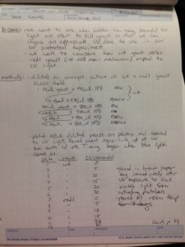
What is a Lab Book?
Version 1 from 22. august 2023

Slide 9
Why do we keep lab notes?
To document that we have actually done what we have done → patents / documentation for staying within standards (GxP)
To remember what we have done
Troubleshooting is impossible without notes!
So that others can repeat what we have done
To be able to write a report in the end!!
Version 1 from 22. august 2023

Slide 10
What to write?
Date + operator(s)
Overall tasks which have been/should be completed
Keeping track of samples taken + storage of samples → Names of samples must be documented in lab books
Arbitrary numbers could be given to samples
When documenting media formulation → write what you did not what the recipe said you should do!
Write down mistakes → do not delete typos or remove pages
What is the name of a datafile generated
Where is the datafile stored
Safety →gloves, fume hood, goggles etc.
Any special/hazardous waste
Version 1 from 22. august 2023

Slide 11
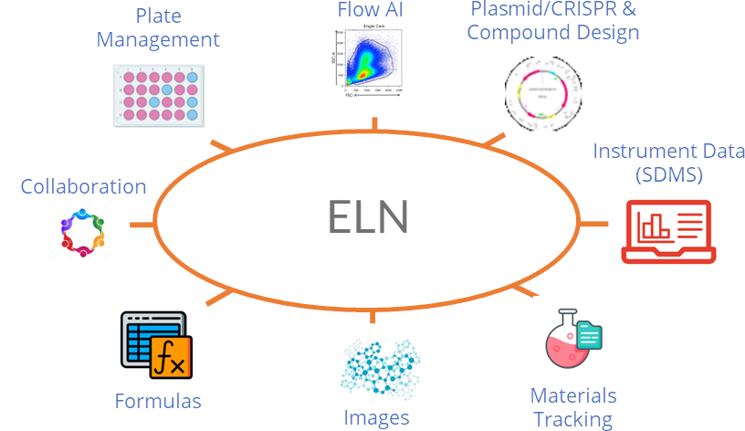
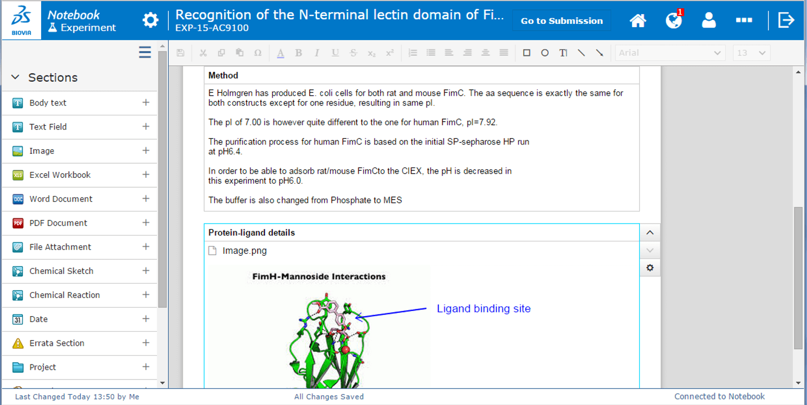
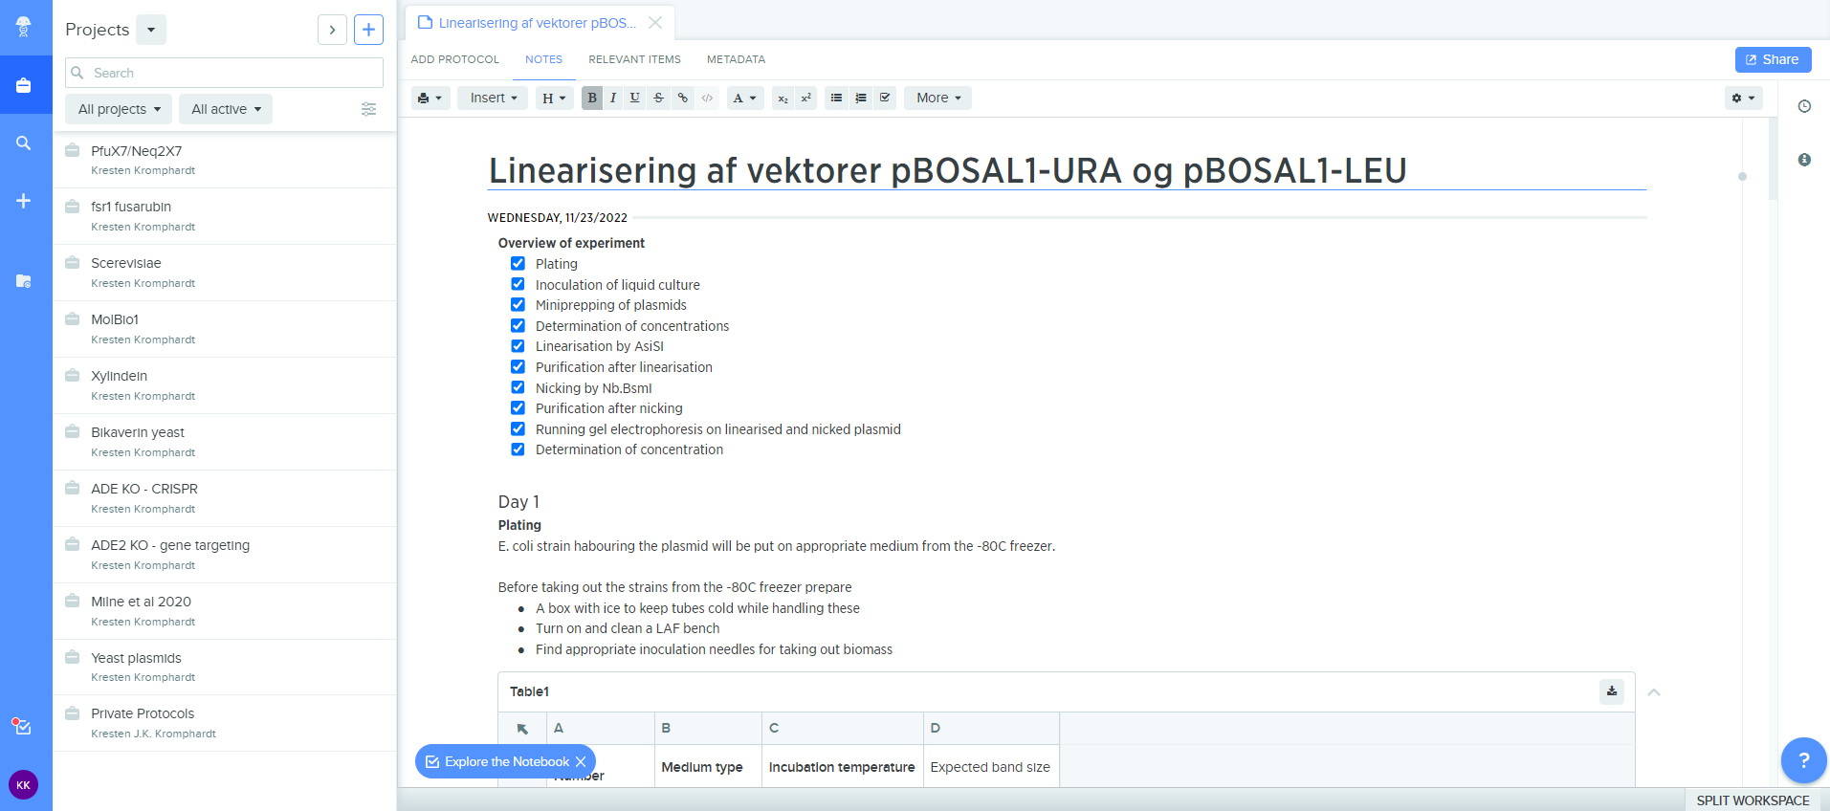
Electronic Lab Notebooks (ELN’s)
Version 1 from 22. august 2023

Slide 12
ELN vs. pen and paper
ELN’s are used extensively in regulated environments (pharma, biotech industry, clinical diagnostics etc.)
Print instructions which you will be using multiple times → i.e., Lab manual
Find the right ELN for you: https://www.nature.com/articles/d41586-018-05895-3
Version 1 from 22. august 2023

Slide 13
”How to do lab reports”
Majbrit Madsen
Version 1 from 22. august 2023

Slide 14
Why do we do lab reports?
To document what we did and conclude on results and follow the IMR&D structure (introduction, methodology, results, discussion, and conclusion) with some additional elements.
Report concept:
https://www2.phabsalon.dk/fileadmin/user_upload/Studiesite/Diplomingenioer_i_bioteknologi/LabReport_Instructions_v2.pdf
Version 2 from 10 February 2025

Slide 15
Why do we do lab report review?
To ensure professional output but avoid obvious mistakes
Input to Check list for review:
Do it fit to the standard (sections, length, title data)
Figures, tables and pictures
Consecutively numbering
Standalone explanation text
Reference in text to all
References when stating facts
Check that all references are used in text
All references must be relevant, remember to refer to protocol
Did we include what was required?
Is there a conclusion on the results and perspectivation to literature if relevant?
Is all theory relevant for this report?
No new information in Discussion or Conclusion section
Relevant facts must be introduced in the Introduction section
Version 1 from 22. august 2023

Slide 16
Changelog
version | changes
Version 1 from 22. august 2023 | New document
Version 2 from 10 February 2025 | Link at slide 14
Version 2 from 10 February 2025

